Slide 1
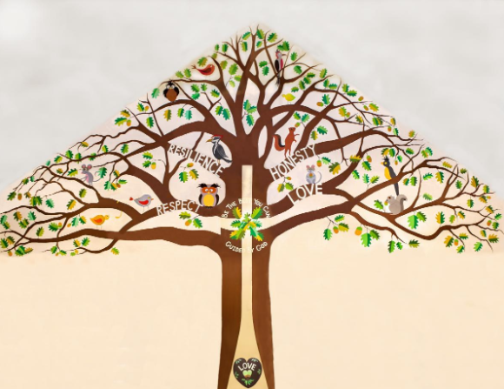
Welcome to Willow Class

Slide 2
A Typical Day – Autumn Term
Registration
Phonics/English/Writing
Assembly/Snack
Playtime
Maths
Lunchtime
Reading/Topic/Jigsaw/Zones

Slide 3
A Typical Week – Autumn Term
Day | 8:45-10:10 | 10:10-10:30 | 10:45-12:00 | 12:00-13:00 | 13:00-14:30 | 14:30-15:15
Monday | Phonics/English | Snack/Play Assembly | Maths | Lunch | Reading/Jigsaw | Tidy Up/ Storytime/ Hometime
Tuesday | Phonics/English | Snack/Play | Maths | Lunch | Reading/ Topic | Tidy Up/ Storytime/ Hometime
Wednesday | PE | Snack/Play Assembly | Maths | Lunch | Reading/ Topic Assembly | Tidy Up/ Storytime/ Hometime
Thursday | Phonics/English | Snack/Play | Music | Lunch | Reading/ Topic Assembly | Tidy Up/ Storytime/ Hometime
Friday | Assembly Phonics/English | Snack/Play | Maths | Lunch | PE / Music | Tidy Up/ Storytime/ Hometime
Reception children join the rest of the school for assemblies and playtimes when they are ready to.

Slide 4
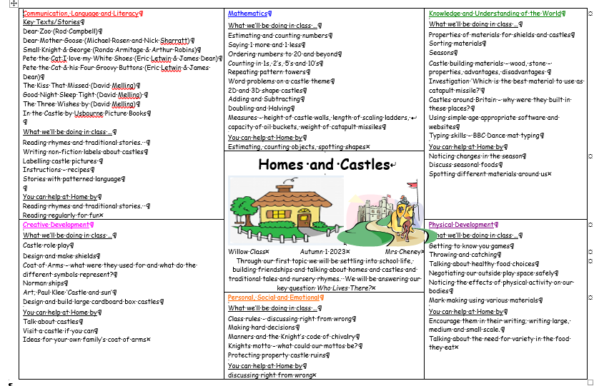
Our Theme Overview – Homes and Castles

Slide 5
Home Learning
This should include:
Daily reading (and recording in Reading Diary in KS1) This might be a fiction book, newspaper, magazine, non-fiction book, instructions, recipe, directions or any form of writing!
Using real life maths – shopping, baking, measuring and telling the time for example.
Any additional home learning set by class teacher and Magic Moments

Slide 6
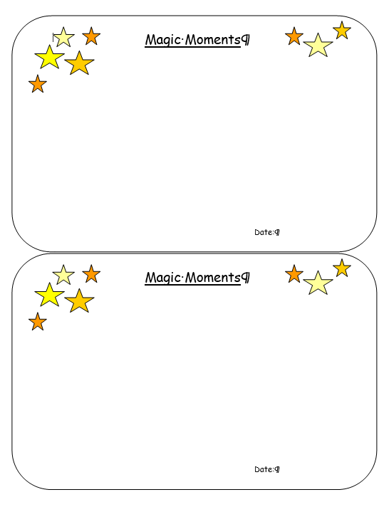
Magic Moments
Write down anything you notice at home that you would like us to celebrate in class.

Slide 7
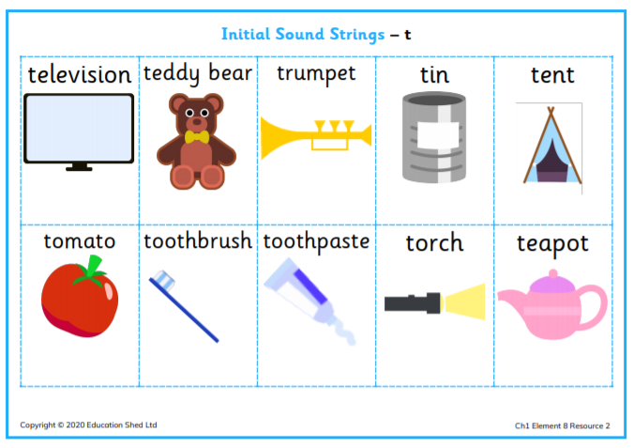
Phonics
We will start phonics in the next month. In the meantime keep reading the great quality storybooks that come home every day.

Slide 8
Quick Reminders
Water bottles
P.E kits in school every day
Reading Diaries and reading books in book bags every day (EYFS/KS1)
Make sure clothes and PE kit are clearly labelled with the correct name - especially second hand uniform
Check the uniform policy

Slide 9
Useful Information
School Website: https://www.bolneyschool.org.uk/
School Phone Number: 01444 881352
Email Zoe in the office: office@bolneyprimary.school
Class Teacher email: scheney@bolneyprimary.school
Please do not expect an immediate response. If you message is urgent, email the school office.

Slide 10
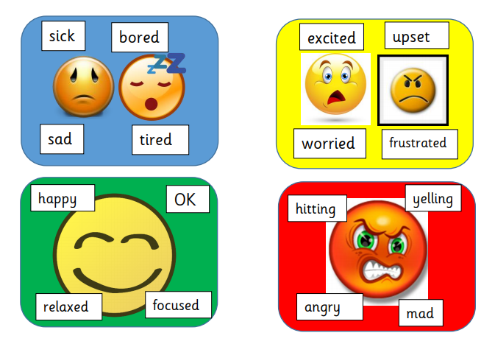
Well-being
Anna Freud Centre for Children and Families
Zones of Regulation – more information on the school website
Talk to your children and talk to us – we are here to listen and help.

