Slide 1
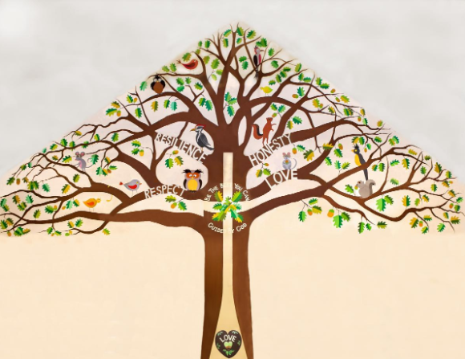
Welcome to Silver Birch Class

Slide 2
A Typical Day
Maths
Assembly
Spelling/Handwriting
Whole class reading (VIPERS)/independent reading
English
Lunchtime
Project Work (Art, Computing, History, Geography, Science)
Other areas of the curriculum- Drama, French, Music, P.E

Slide 3
A Typical Week
 | 8:35-8.55 | 8.55- 9.15 | 9.20-10:30 | 10:30-10:45 | 10:45-12:00/12:10 | 12:00/ 12:10 – 1:00 | 1:00-2:00 1.30-2.50 | 2:00-3:15
Monday | E B | Singing (Teachers in/rota) | Maths Vipers | B | Spelling Handwriting English | L | Art/Learning for Life/RE Carole
Tuesday | A I | KS WORSHIP | Maths Vipers | R | Spelling Handwriting English | U | History/Geography/Project work No TA
Wednesday PPA | R R | WORSHIP (RB in) | Music Grammar/Mental Maths | E | PE | N | Drama (2.05-3.05) Interventions CJ French (1.30-2.00) VIPERS Story
Thursday | L D | WORSHIP (TA’s in) | Maths Vipers | A | Spelling Handwriting English | C | PE/English/Maths (1.15-2.05) (2.10-3.00) Carole
Friday | Y | CELEBRATION Spelling Science |  | K | Science Vipers | H | Finishing off/Presentation of work No TA | Computing Story

Slide 4
Our Autumn term learning journey, please see copies on tables and please take one home.

Slide 5
Home Learning
This should include:
Daily reading -This might be a fiction book, newspaper, magazine, non-fiction book, instructions, recipes, directions or any form of text!
Times Table Practice using the website ‘timestables.co.uk’ and TT Rockstars
Using real life maths – shopping, baking, measuring and telling the time for example

Slide 6
Spellings- common exception words and spelling patterns taught in school using Spelling Frame/Spelling Shed or completing a paper copy, given out on Fridays.
All children need to complete the home learning set- your child may be working on Year 2/3/4 words but you can still use Spelling Frame and Spelling Shed for these words. Please find copies of the CEW on tables and please take one.
A Topic grid every term linked to the big question.
In UKS2, if home learning isn’t handed in, children miss one of their break times in order to complete it.

Slide 7
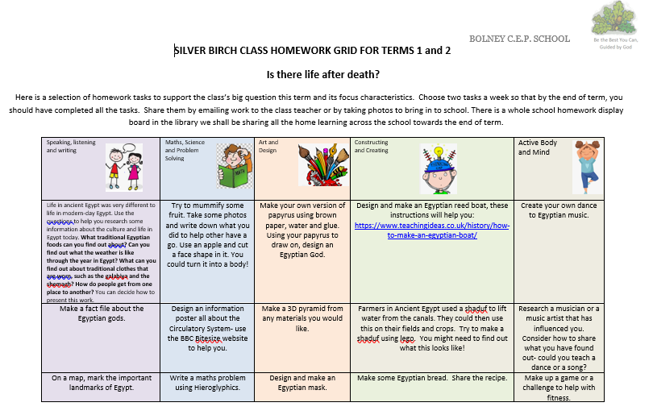
Our Autumn term home learning grid

Slide 8
More about reading…
We read daily and I always read to the children. We have independent reading time where the children are able to read in the book corner and we have whole class reading time where we all read together, myself and the children and we read the same text.
VIPERS is an acronym to aid the recall of the 6 reading domains as part of the UK’s reading curriculum. Reading Vipers
Vipers is a range of reading prompts based on the 2016 reading content domains found in the National Curriculum Test Framework documents.
To be able to fully embrace Vipers, we need to purchase enough books for every child. I will give you notice about the book I would like us to use at the end of each term for the start of the next term. Thank you for your ongoing support with this- it has been really helpful.
SATS- we practise regularly using reading booklets to ensure the children have no surprises when faced with a SATS paper. The Year 5’s are also familiar with these as we use them to regularly assess reading. I will contact Year 6 parents nearer the time regarding any extra support/home support you may need.

Slide 9
If you would like to take a recommended book list for Years 5 and 6, please help yourself!

Slide 10
Quick Reminders
Bring a named water bottle to school
Wear P.E kits on P.E days (Wednesday and Thursday)
Make sure clothes are clearly labelled with the correct name - especially second hand uniform
Change of clothes for Forest School (We will send out reminders when we are doing this)
Check the uniform policy- black and white socks only please!
All documents- home learning, letters, spellings etc are all on our class page on the website.

Slide 11
Useful Information
School Website: https://www.bolneyschool.org.uk/
School Phone Number: 01444 881352
Email Zoe in the office: office@bolneyprimary.school
Class Teacher email: cjames@bolneyprimary.school
Please do not expect an immediate response. If your message is urgent, email the school office. I do use Brom Com for most emails and correspondence, please let me know if this is a problem.

Slide 12
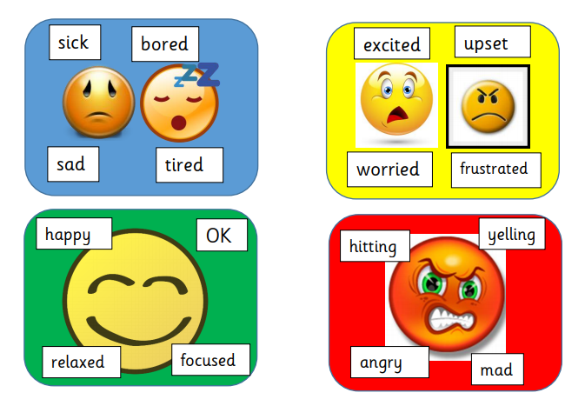
Well-being
Anna Freud Centre for Children and Families
Zones of Regulation – more information on the school website
Talk to your children and talk to us – we are here to listen and help

