Slide 1
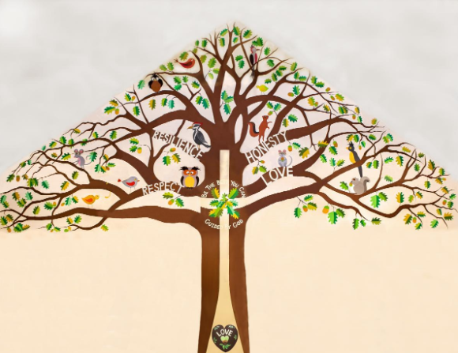
Welcome to Holly Class

Slide 2
A Typical Day
Maths
Assembly
Spelling/Handwriting
Whole class reading (VIPERS)/independent reading
English
Lunchtime
Project Work (Art, Computing, History, Geography, Science)
Other areas of the curriculum- Drama, French, Music, P.E

Slide 3
A Typical Week
 | 8:35-9:00 | 9:00-10:10 | 10:10-10:30 | 10:30-10:45 | 10:45-12:00/12:10 | 12:00/ 12:10 – 1:00 | 1:00-2:00 1.30-2.50 | 2:00-3:15
Monday | E B | Music | WORSHIP (Teachers in) | B | Spelling Handwriting Maths/English Vipers | L | English/Maths depending on morning |  | R.E Story
Tuesday | A I | Spelling Handwriting English | KS WORSHIP | R | Maths Vipers | U | Art/Project work Story
Wednesday | R R | Spelling Handwriting English | SINGING Handwriting intervention AMB | E | Maths Vipers | N | Drama (1.10-2.00) Interventions EL/AMB/CJ French (2.00-2.30) Narrative Therapy RB Project Story
Thursday | L D | Spelling Handwriting English | WORSHIP (TA’s in) | A | Vipers Maths | C | PPA P.E | PPA RHE Story
Friday | Y | CELEBRATION Spelling Science |  | K | Science Vipers | H | Computing Forest Schools | Computing Forest Schools Story

Slide 4
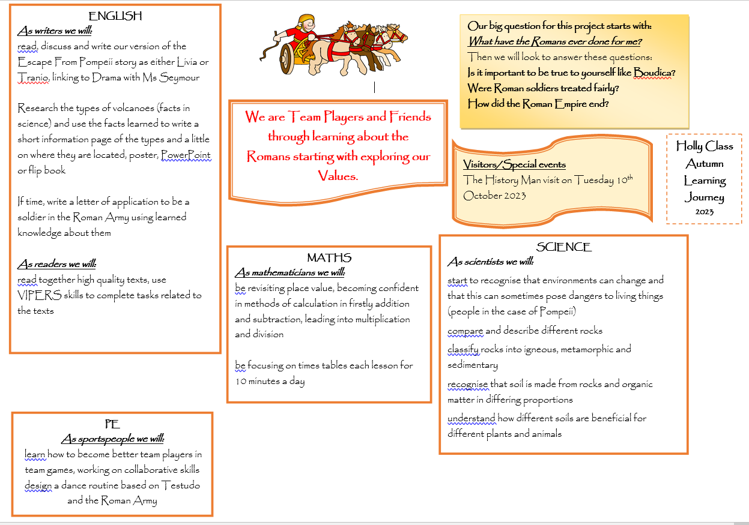

Slide 6
Home Learning
This should include:
Daily reading -This might be a fiction book, newspaper, magazine, non-fiction book, instructions, recipes, directions or any form of text!
Times Table Practice using the website ‘timestables.co.uk’ and TT Rockstars
Using real life maths – shopping, baking, measuring and telling the time for example

Slide 7
Spellings using Spelling Frame which will be loaded onto Teams every Friday. A paper copy will be given to children if they require it. You do not need to hand work in unless you want to!
Children that use Nessy for spelling in school need to use this for their home learning- they can also log into spelling frame for variety!
A Topic grid every half term linked to the big question.

Slide 8
More about reading…
We read daily and I always read to the children. We have independent reading time where the children are able to read in the book corner and we have whole class reading time where we all read together, myself and the children and we read the same text.
VIPERS is an acronym to aid the recall of the 6 reading domains as part of the UK’s reading curriculum. Reading Vipers
Vipers is a range of reading prompts based on the 2016 reading content domains found in the National Curriculum Test Framework documents.
To be able to fully embrace Vipers, we need to purchase enough books for every child. I will give you notice about the book I would like us to use at the end of each term for the start of the next term.

Slide 9
If you would like to take a recommended book list for Years 3 and 4 please help yourself!

Slide 10
Quick Reminders
Bring a named water bottle to school
Wear P.E kits on P.E days (Thursday)
Make sure clothes and PE kit are clearly labelled with the correct name - especially second hand uniform
Change of clothes for Forest School
Check the uniform policy
Swimming will start in January- usually on a Wednesday

Slide 11
Useful Information
School Website: https://www.bolneyschool.org.uk/
School Phone Number: 01444 881352
Email Zoe in the office: office@bolneyprimary.school
Class Teacher email: cjames@bolneyprimary.school
Please do not expect an immediate response. If your message is urgent, email the school office.

Slide 12
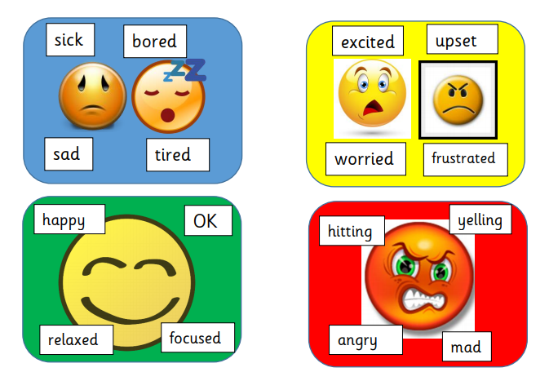
Well-being
Anna Freud Centre for Children and Families
Zones of Regulation – more information on the school website
Talk to your children and talk to us – we are here to listen and help

