Slide 1

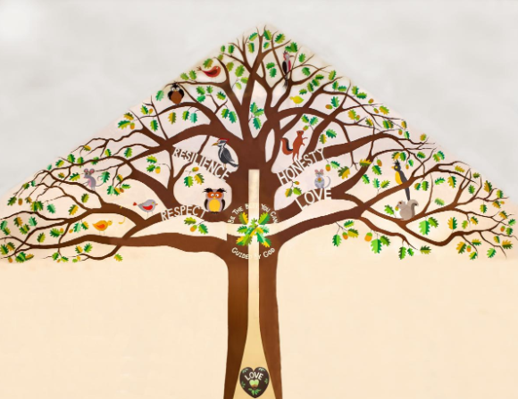
Welcome to Beech Class

Slide 2
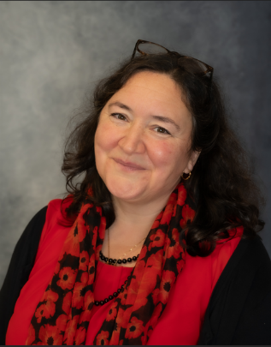
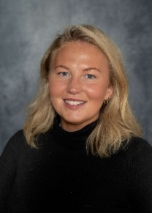
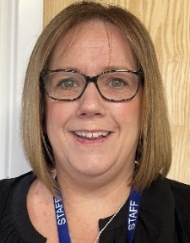
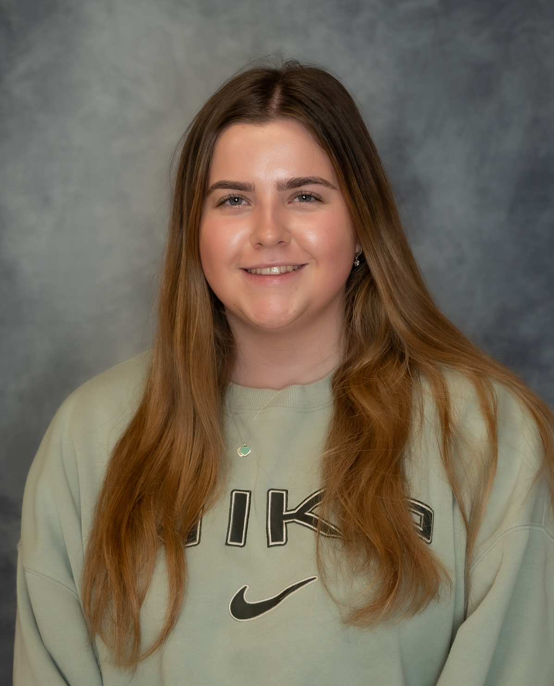
Teachers
Mrs Cheney Miss Bryant Mrs McInnes Miss Curtis

Slide 3
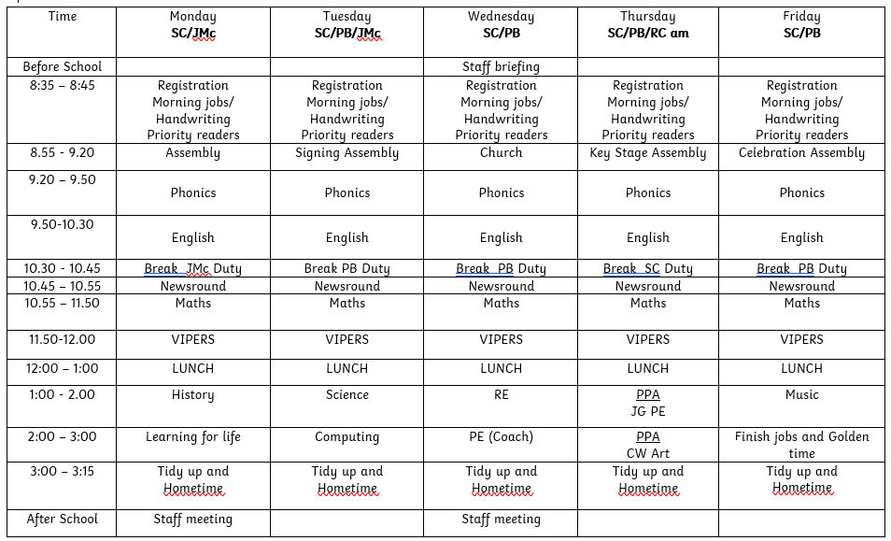
A Typical Week

Slide 4
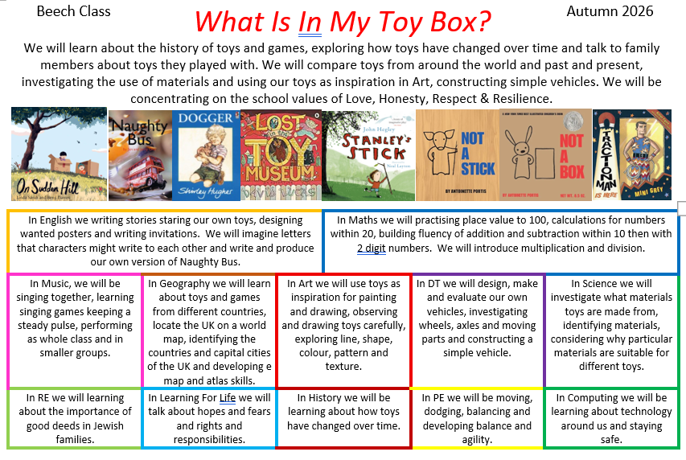
Our Big Question Overview

Slide 5
Home Learning
Please read daily at home (and write it in your child’s Reading Diary) –
Children will be given a phonics book from our scheme and are welcome to choose from our class book area and school library. If they are reading anything else at home, fiction, newspaper, magazine, non-fiction book, instructions, recipe, directions or any form of reading please add it in!
Times Table/Maths Practice –
You can use Numbots or TT rockstars for maths activities at home. The login is the same for both and can be found in your child’s diary.
Real life maths – shopping, baking, measuring and telling the time for example.
Spellings –
I will set a weekly spellings list on Friday, sent home as a paper copy in a Weekly Spellings Book, with a spelling check in class on Thursday mornings. The spellings are based on sounds and patterns we have looked at in class and some common exception words, where the usual spelling rule doesn't apply).

Slide 6
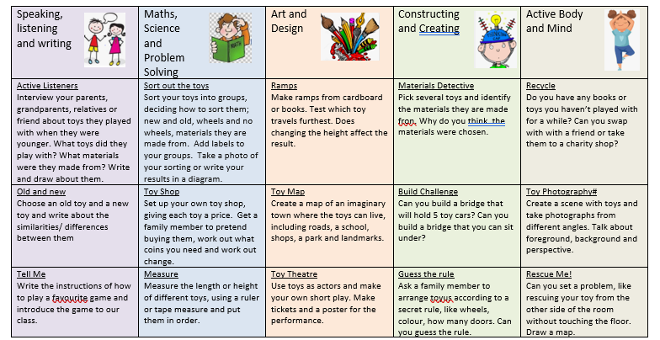
Home Learning
Homework Grid – This is on the website and has been emailed to you. It is full of a range of activities for you and your child to enjoy!

Slide 7
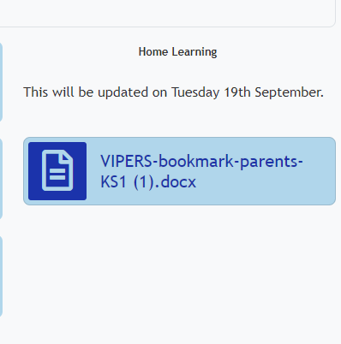
Reading
Daily reading (and recording in Reading Diary) –
Books will be changed in class on Tuesdays and Fridays by staff. The children will be given a ‘reading level’ book. Please put books in bookbags or we cannot change them. If you find that children are reading the book at speed after a few days, my advice would be to use the VIPERS suggestions from the back of the diary.
Reading in Class
Your child will have the chance to read at school 1-1 with a TA and myself during the week. This reading will be recorded in your child’s reading diary so please bring it everyday.

Slide 8


Next Topics
Summer 2027
Could Fish Live In Trees?
Spring 2027
Who Encourages Us To Dream Bigger?

Slide 9
Quick Reminders
Bring a water bottle to school
Fruit or vegetable snack at break
Small toys (golden time)
Wear PE kits on PE days (Wednesday and Thursday)
Reading Records and reading books in book bags every day, especially book changing day
Make sure clothes and PE kit are clearly labelled with the correct name - especially second hand uniform
Check the uniform policy – ks1 shouldn't have backpacks

Slide 10
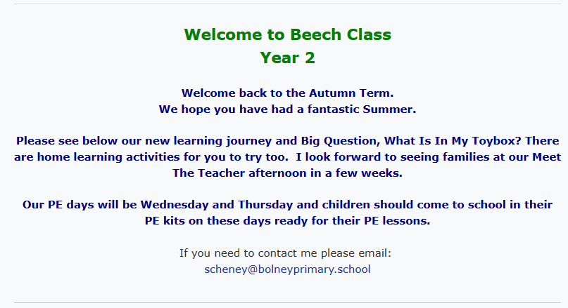
Our school website
https://www.bolneyschool.org.uk/web/

Slide 11
Useful Information
School Website: https://www.bolneyschool.org.uk/
School Phone Number: 01444 881352
Email Zoe in the office: office@bolneyprimary.school
Class Teacher email: scheney@bolneypriamry.school
I will respond to your email but if it’s urgent please email or call the school office.

Slide 12
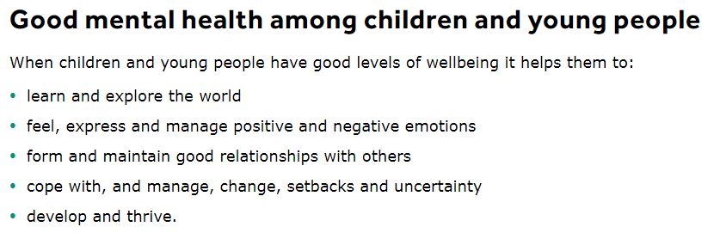
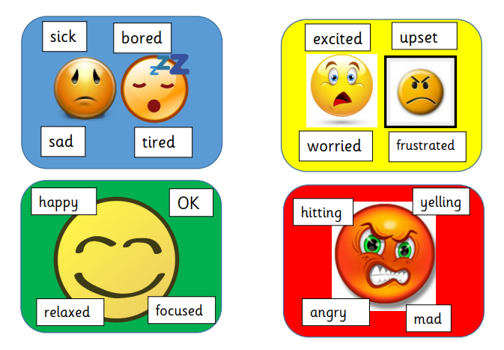

Well-being
Talk to your children and talk to us – we are here to listen and help.

