Slide 1



Bolney CEP School
Anti-Bullying Policy
In November 2022, we reviewed our Anti-Bullying Policy and made it more understandable for children and adults.

Slide 2
We began with the whole school discussing 5 important questions:
What rights do all children have in school?
What is bullying?
How does it feel to be bullied?
How can we unite to stop bullying?
How do we support someone who has been bullied?

Slide 3
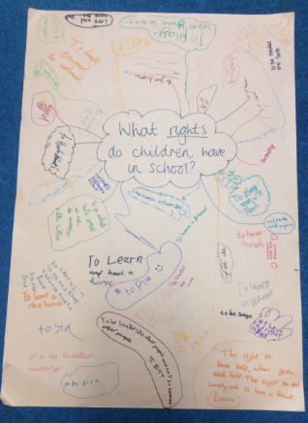
What rights do all children have in school?
The children said:
To be safe
To look forward to coming to school
To be happy
To be treated equally
To not be alone
To be treated like other people
To learn
To not be hurt

Slide 4
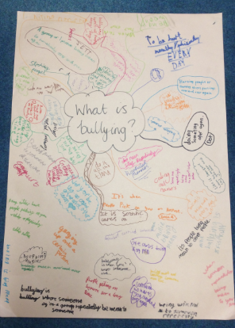
What is bullying?
The children said:
Being hurtful online
When you hurt someone mentally
or physically
When you hurt someone over and over again
Repeatedly being mean
Something done over and over again
When someone says stop and you don’t
Picking on someone on purpose
Cyber bullying
Being rude to someone longer than a day

Slide 5
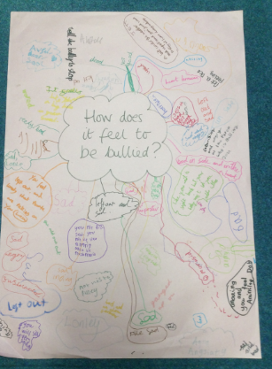
How does it feel to be bullied?
The children said:
You feel left out
Unsafe
Frustrated
Don’t want to come to school
Sad and angry
Bad inside
Anxious
As if you don’t want to be here
Hurting inside
Lonely
Uncomfortable

Slide 6
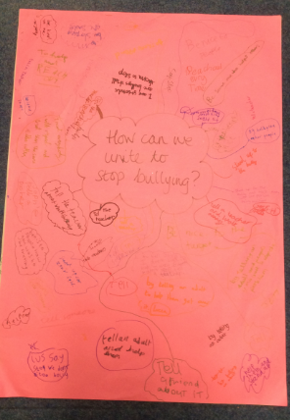
How can we unite to stop bullying?
The children said:
Be someone who helps others
Tell bullies, “STOP!”
Tell a teacher
Ask the bully, “ How would
you like it?”
Walk with the bullied person on the playground
Show them that it
is wrong
Reach out!
Help people to stand up to them
Be kind to everyone

Slide 7
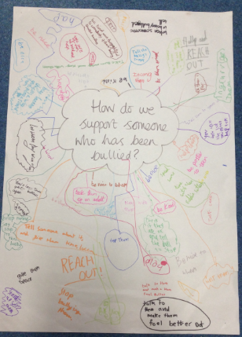
How do we support someone who has been bullied?
The children said:
Tell them bullies are cowards and it’s not their fault
Check if they are ok
Be a good friend
Tell a teacher they are upset
Reach out
Play with them if they
are alone
Talk to them if they are sad
Stand up to
the bully
Make them laugh if they are down

Slide 8
Our responsibilities so that we can all enjoy our rights
Remember our values
Listen to the opinion of others
Inform an adult if you think someone is being bullied
Avoid being a bystander - if you see bullying taking place, tell an adult
Offer support if you see a child who is upset in school
Tell an adult if you know someone is being mean or rude online
Be kind to all children not just your friends

Slide 9
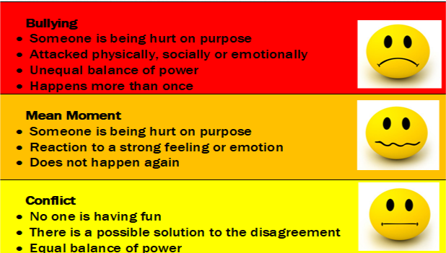
What is bullying?
Bullying is behaviour by an individual or a group, usually repeated over time, that intentionally hurts another individual or group either physically or emotionally. It can take place face tom face or online (cyber bullying).

Slide 10

Anti – Bullying Policy Steps to Safety

Slide 11
Step 1
Reach out and tell someone
If you are being bullied, tell someone. This might be an adult at home, your brother or sister, a friend or an adult in school.

Slide 12
Step 2
The adults will listen to you.
This is your opportunity to talk about what has happened and how this has made you feel. You can ask that we invite your parent or carer to join this conversation.

Slide 13

Step 3
Form a support group
The adult will ask a group of children to help support the person that is being bullied.

Slide 14
Step 4
A teacher or Ms Lofthouse will talk to the child or children accused of bullying.
Children can ask that we invite a parent or carer to join this conversation.

Slide 15
Step 5
A teacher, or Ms Lofthouse will meet with the parents of the child who has been bullied and the child/dren who carried out the bullying.

Slide 16

Step 6
It might take some time before everybody is ready to meet and talk together. The adults will keep this in mind and give everyone space and time to calm down.
During this time the child being bullied will be supported and no further incidents of bullying will be accepted.
Restorative Meeting
A meeting will be held to put things right and it will be run by an adult. This will happen when the person harmed wants it and the person doing the bullying accepts responsibility.
The people at the meeting will talk about:
What has happened;
Who has been affected by the bullying;
How to put things right (see formal agreement on the next slide).

Slide 17

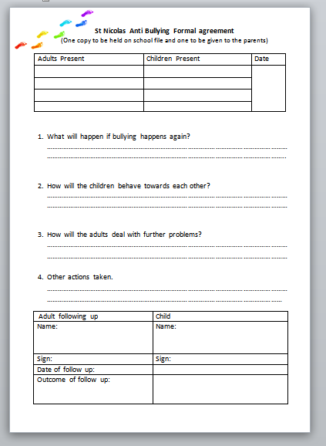
Step 7
Write a formal agreement
A formal agreement is when people come together and decide:
What will happen if bullying happens again;
How children will behave towards each other;
How the adults will deal with further problems.
All children involved will sign the agreement and a copy will be kept in their school files and given to their parents.

Slide 18
Step 8
Follow Up
A teacher, who knows about the bullying, or Ms Lofthouse will follow up and ask everyone if the problem has gone away.

Slide 19

Step 9
Restorative Conference
If the bullying happens again, a full meeting with family and friends of the children involved will be held to make things better. They will talk about the bullying and review the formal agreement.

Slide 20
Step 10
Further follow up
A teacher, who knows about the bullying, or Ms Lofthouse will follow up and ask everyone if the problem has gone away.

Slide 21
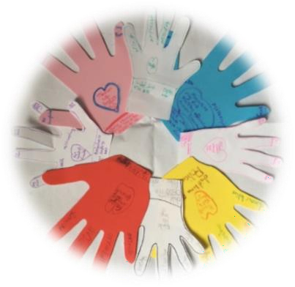
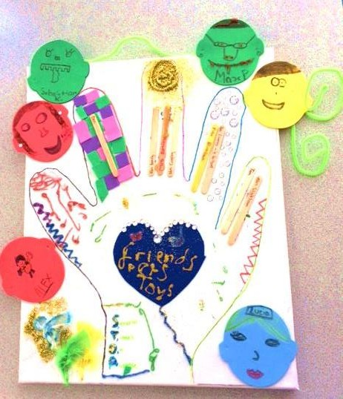

Who to talk to
There is nothing so awful or small that we can’t talk to someone about it.”
There are lots of adults we can talk to in school (see the next slide). All the adults will listen.
You can also pop a note in your class worry box / monster or the worry box in the library.
Remember you can
call Childline about anything that’s worrying you too.

Slide 22
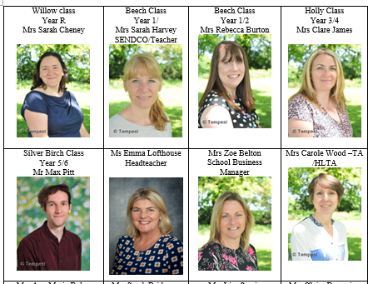
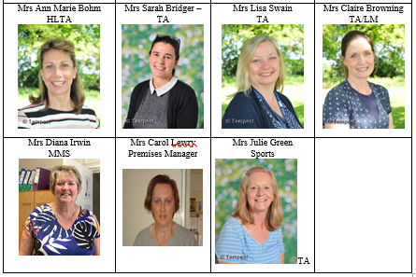
Adults in school you can talk to:

Slide 23
What the school council thought:
Problem | Solution
People won’t want to snitch | The name of the person who shares the information won’t be named
Teachers won’t take it seriously | Trust that they will
The bullying carries on | The steps are repeated
The bullying carries on outside of school | The parents of the bully and the bullied will know about it
There is only one worry box | School Council will make a worry box for each class
Children won’t want a support groups from their class | Older children could be used for a support group
How would someone check in after the steps are finished? | A year 6 role model could be a ‘Check-in buddy’.

Slide 24

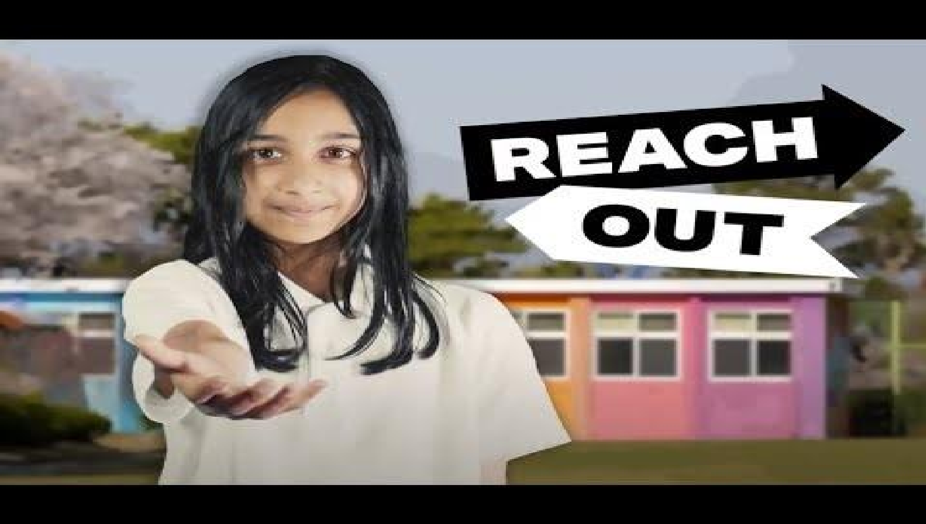

https://www.youtube.com/watch?v=aMfgZRdVbdw
Anti-Bullying Week 2022 – Reach out
24

