Slide 1
Silver Birch Foundation Subjects/Enrichment Evidence
2024-2025

Slide 2
This PowerPoint consists of:
Notes and photos of foundation subjects
Photos and pupil voice of enrichment opportunities

Slide 3
English and History writing
We have been reading Secrets of a Sun King, a story about a girl called Lil who meets some friends and goes to Egypt. We have found out all about King Tut (Kyky) and Howard Carter. We have written:
Time travel narratives
Character descriptions of Kyky
Informal and formal letters
Diary
In History we have written:
Instructions on how to mummify a dolly peg (a human body)
An information page about Egyptian Pharaohs
A description of an Egyptian God

Slide 4
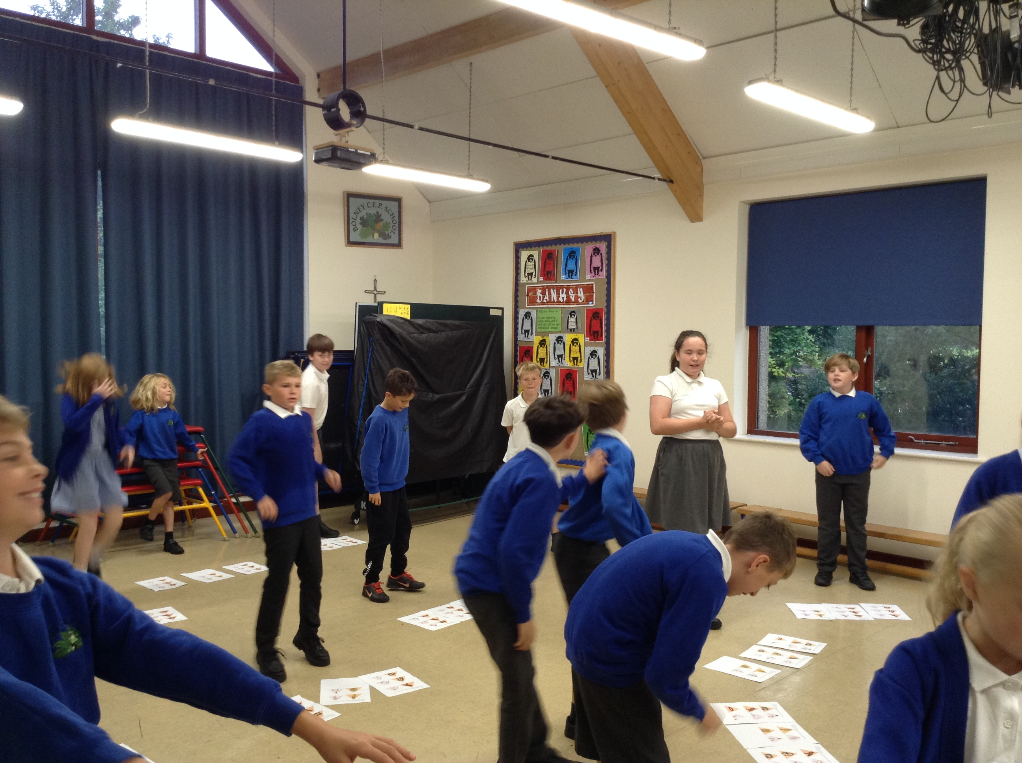
Hook into the project's big question, 'Is there life after death?'
Using hieroglyphics to perform circuit exercises

Slide 5
Horsham Museum Workshop and Table Talk https://www.tabletalk-foundation.com/foodeducation/
First session- Taste, September

Slide 6
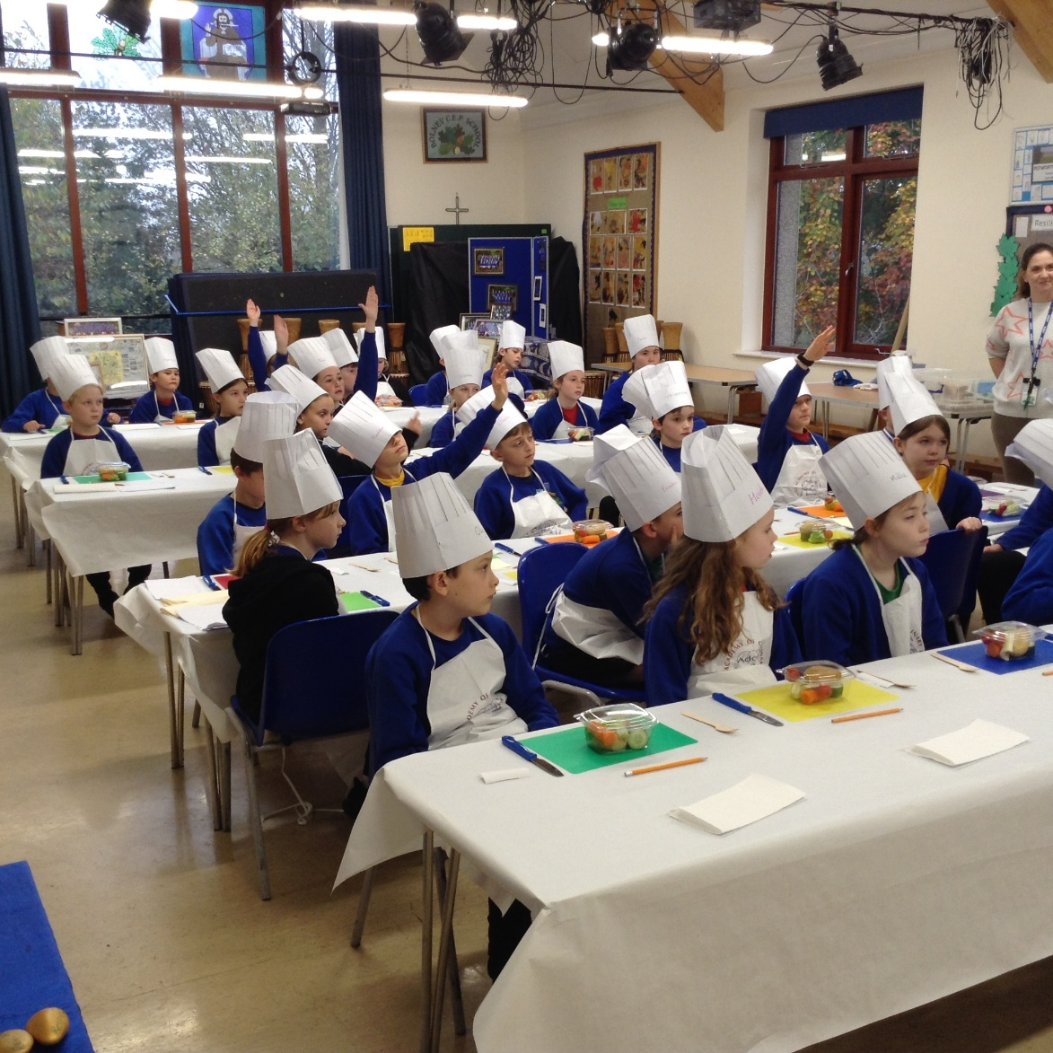
Table Talk- second session- cutting skills and making our own salad!
Best time ever!
November 2024

Slide 7
The NSPCC and their Speak Out, Stay Safe programme came to talk to us about ChildLine and their own services.

Slide 8
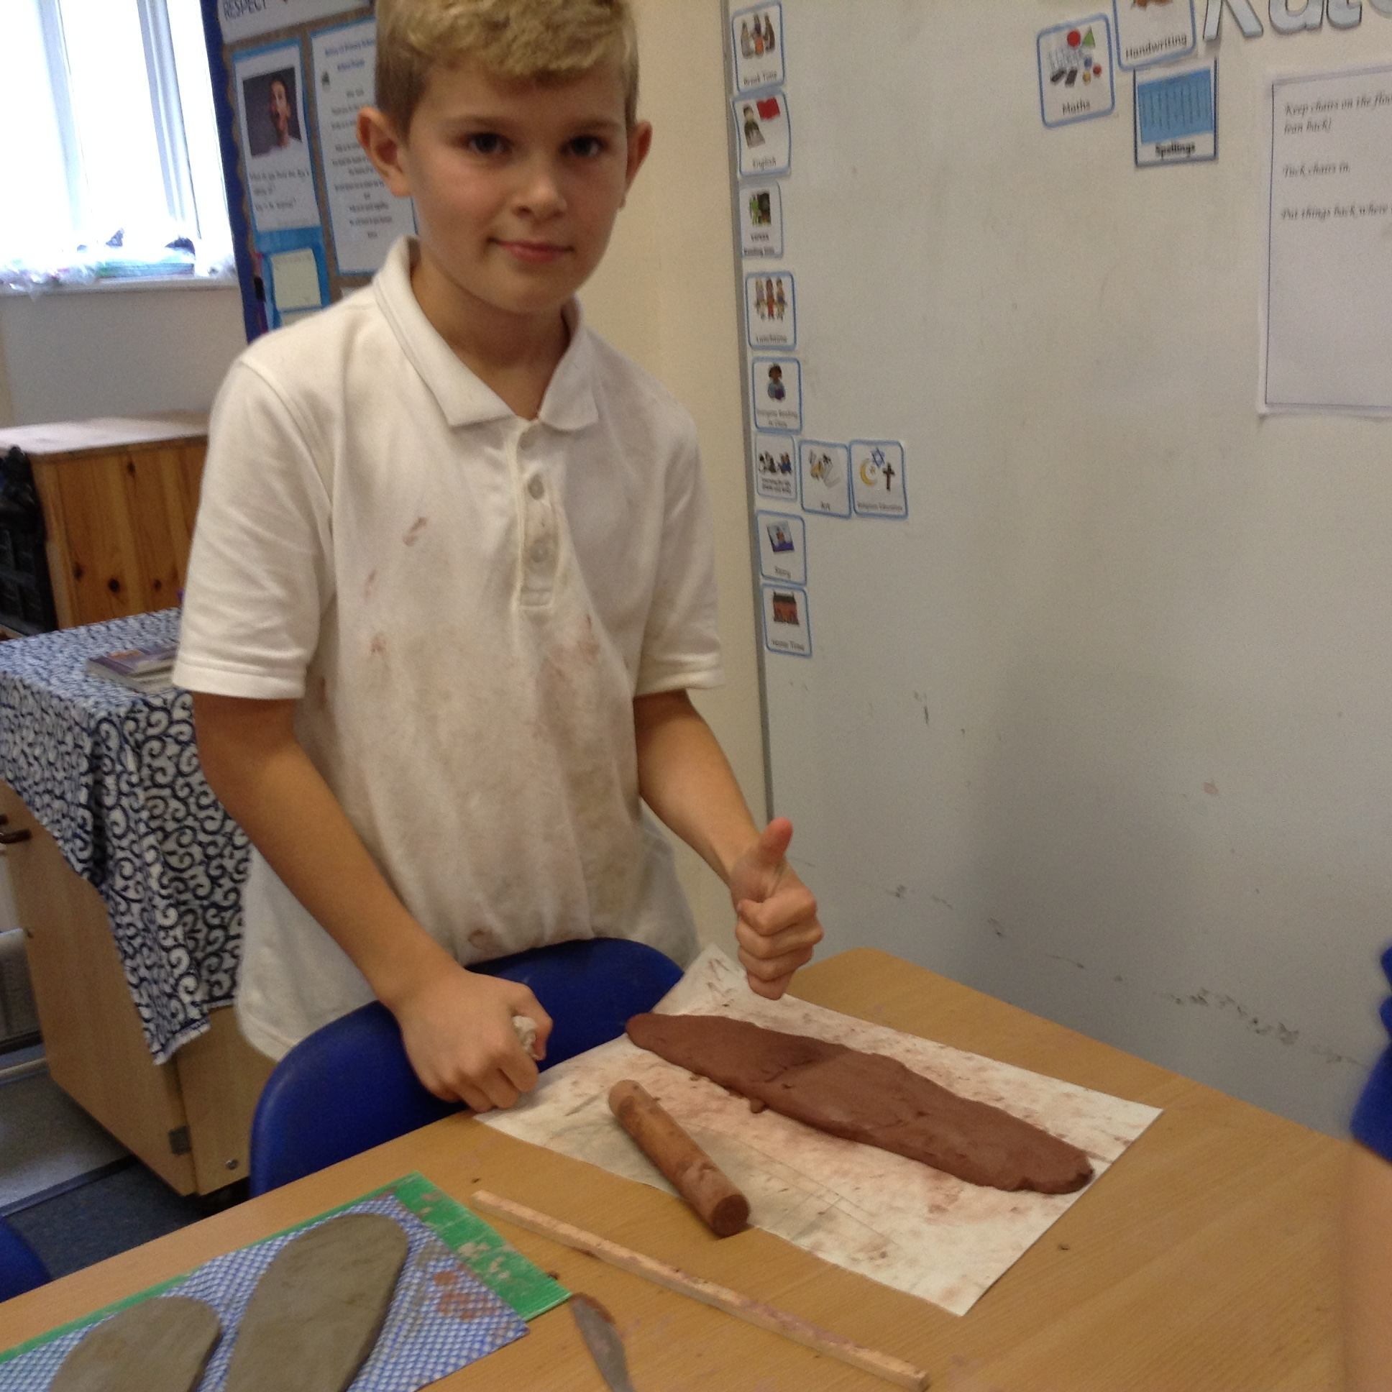
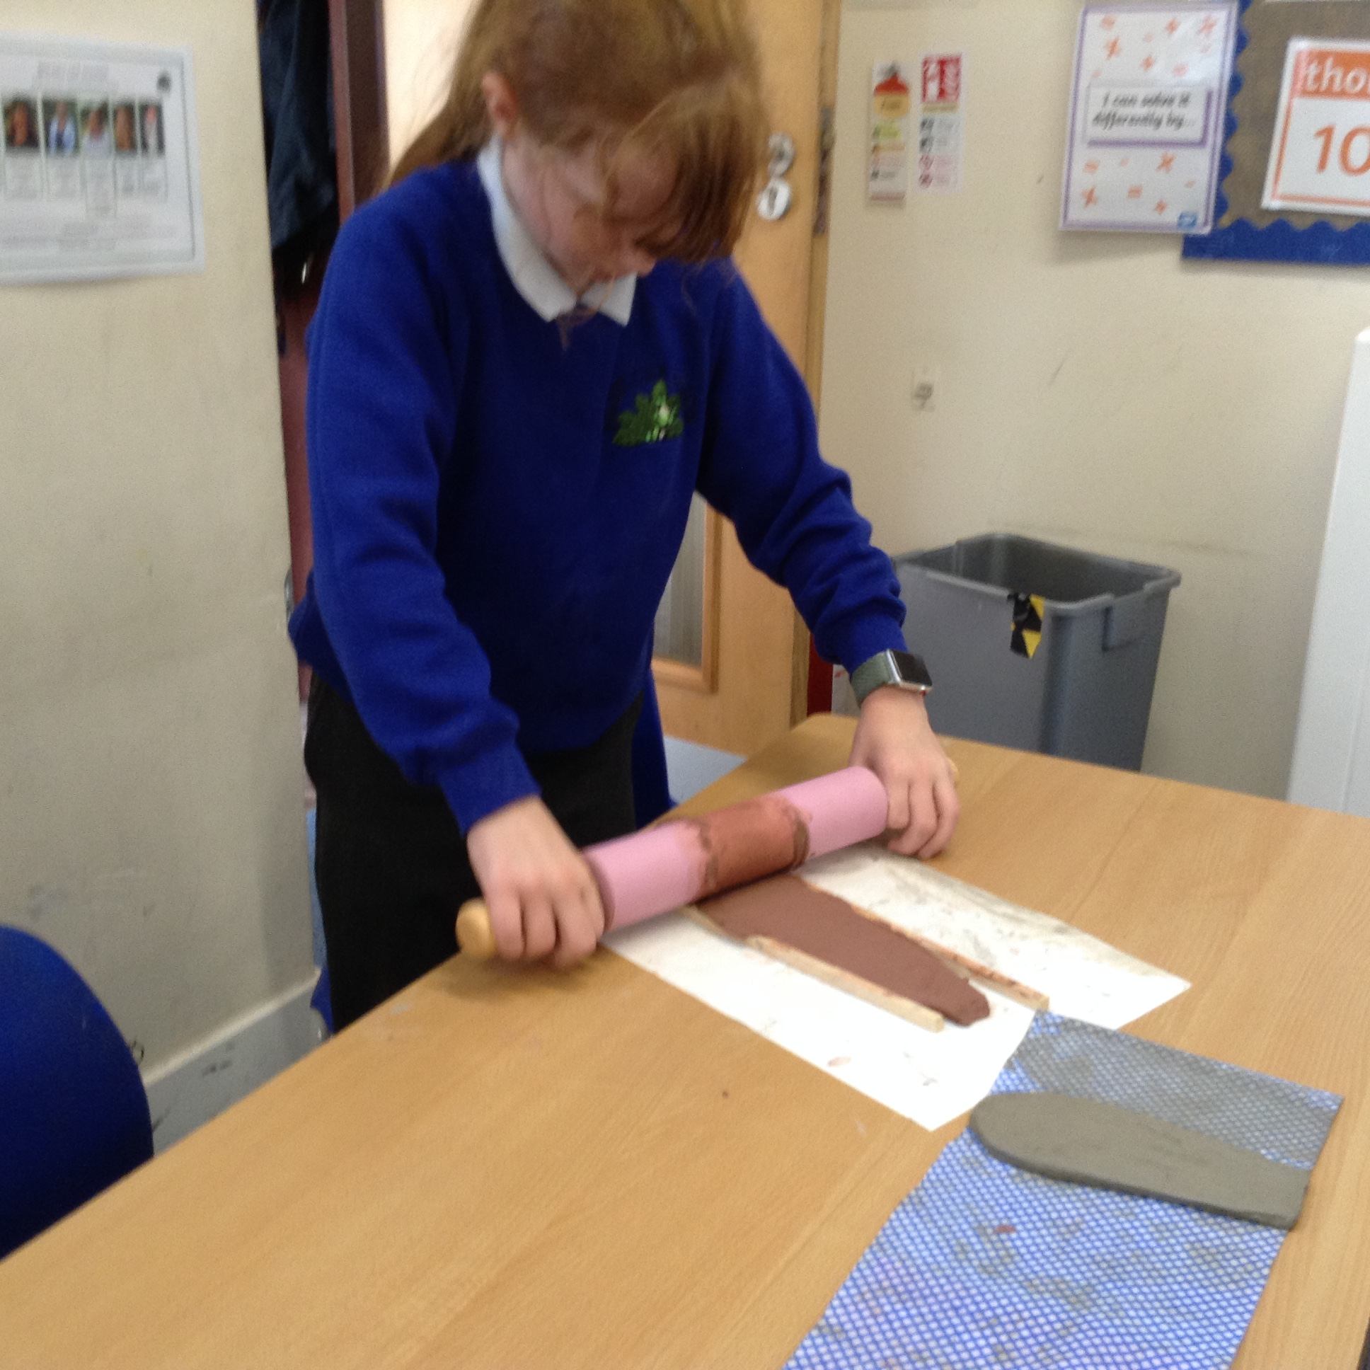
Clay- making Sarcophagus'

Slide 9
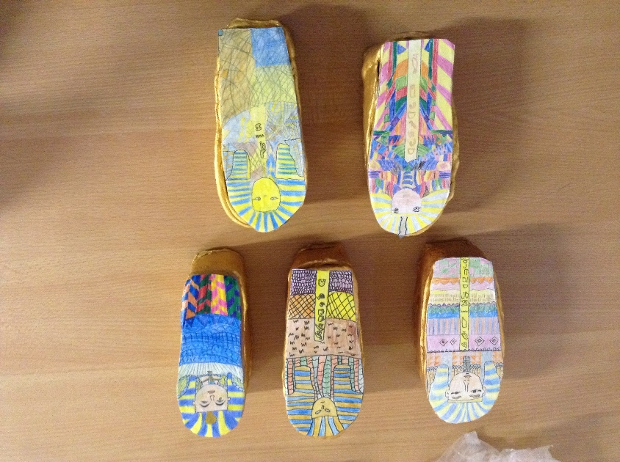
Our finished Sarcophagus!

Slide 10
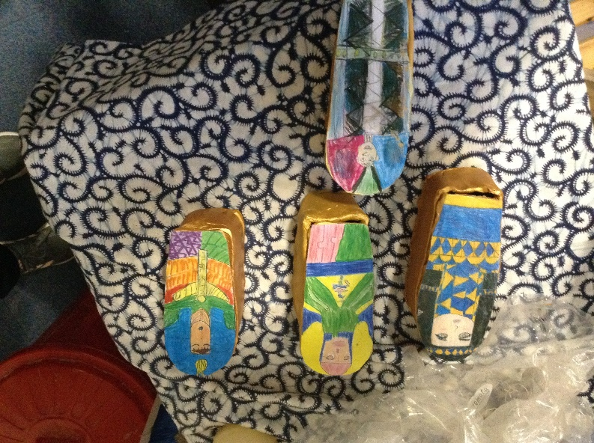
Our finished sarcophagus

Slide 11
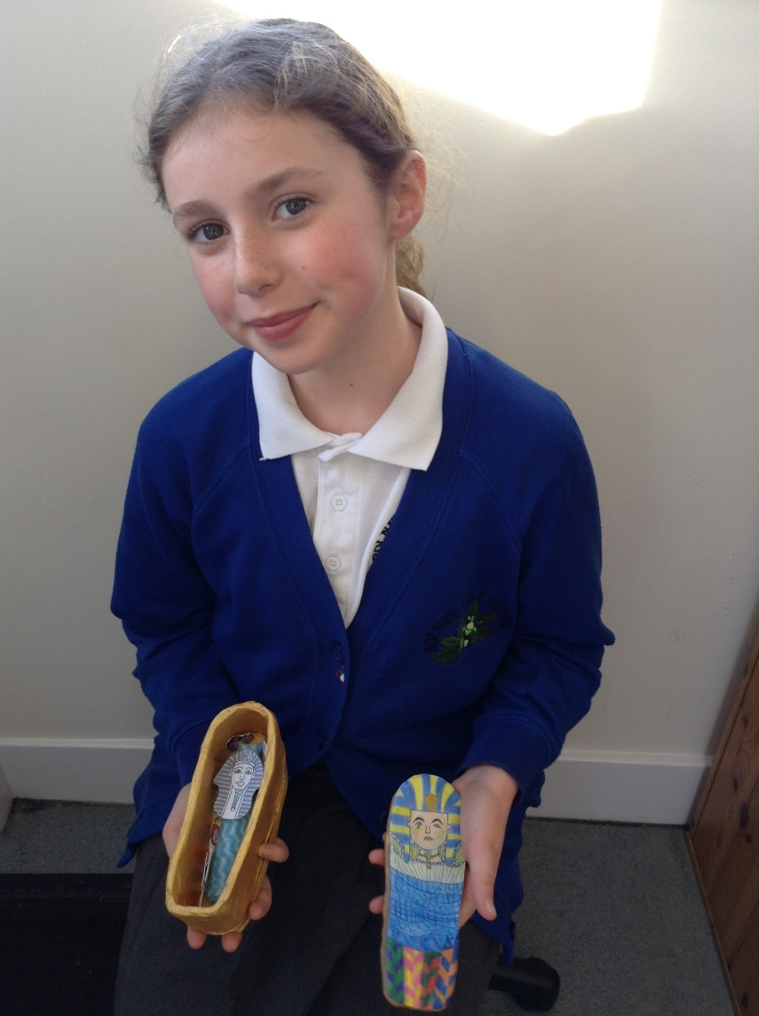
Our finished Sarcophagus

Slide 12
Learning for Life and History
We had to consider the challenges faced by refugees in our learning for life Piece 3 lesson.
Learning all about the four types of pyramids in history.

Slide 13
Sharing our information pages with Willow Class

Slide 14
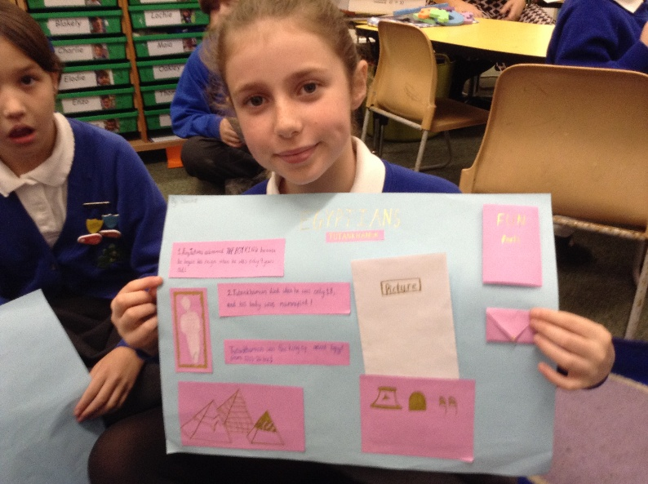
Our information pages about Egyptian Pharaohs

Slide 15
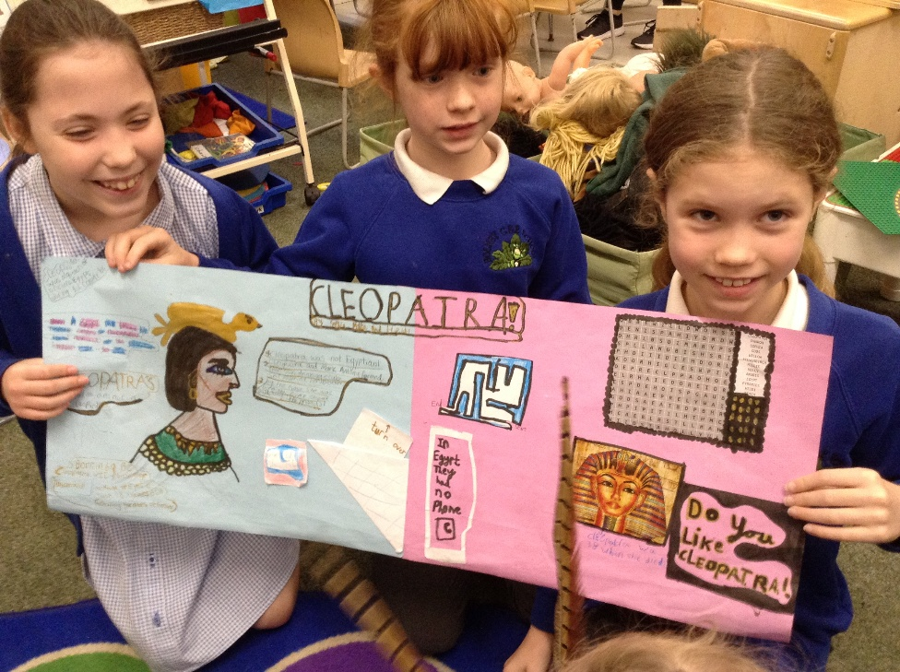
More information pages…

Slide 16
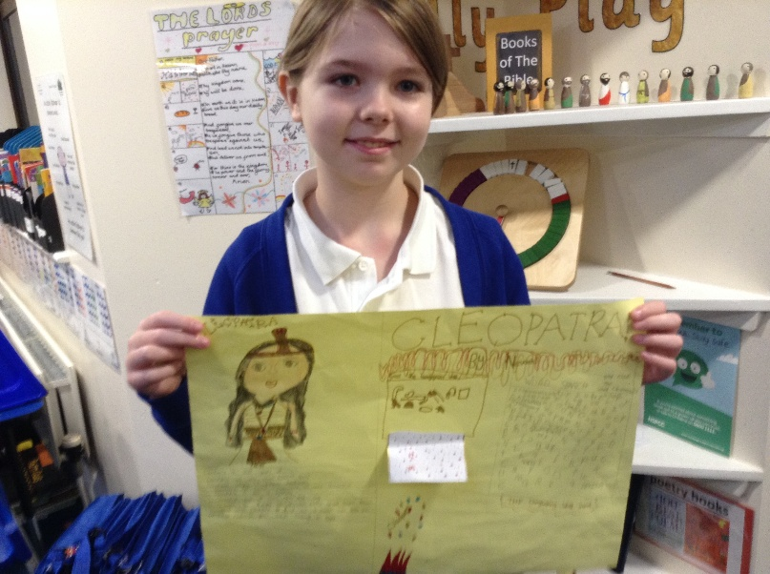
And more…

Slide 17
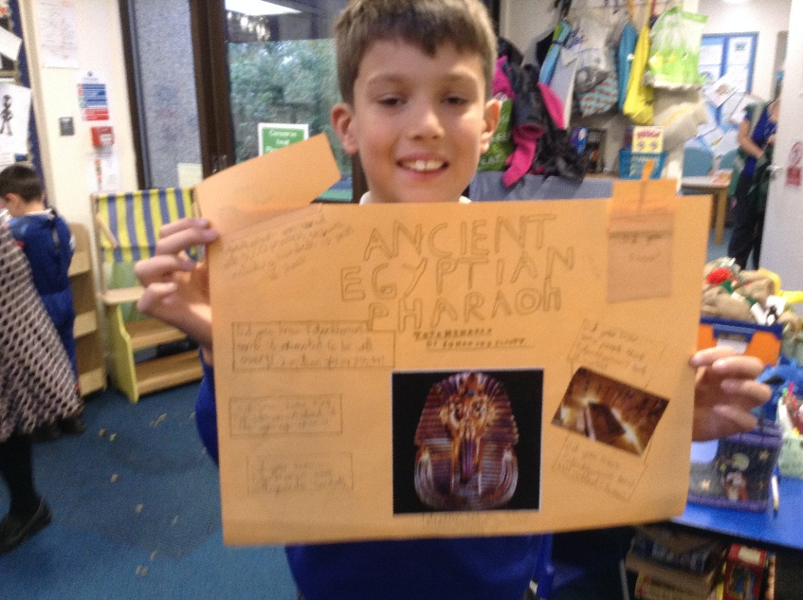
And more…

Slide 18
And more…

Slide 19
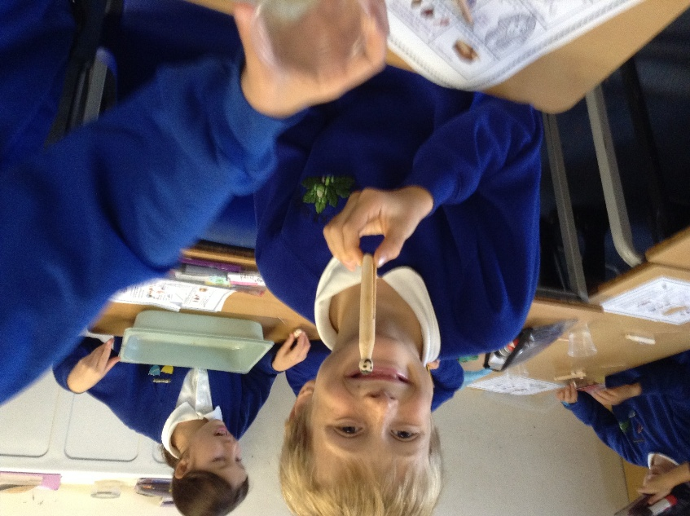
Mummifying dolly pegs and writing instructions

Slide 20
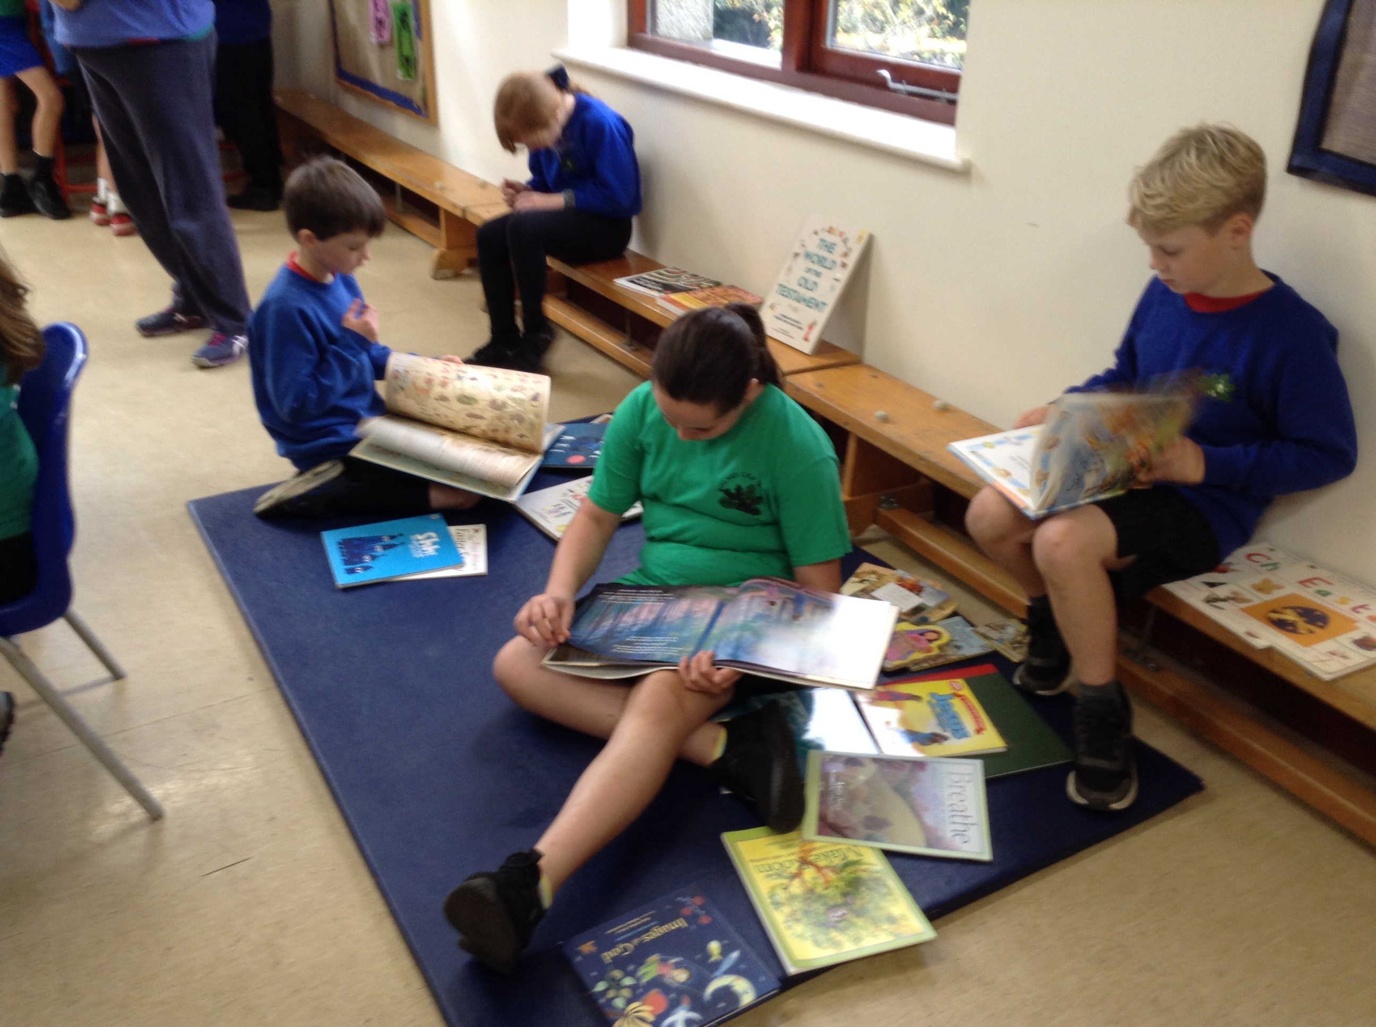
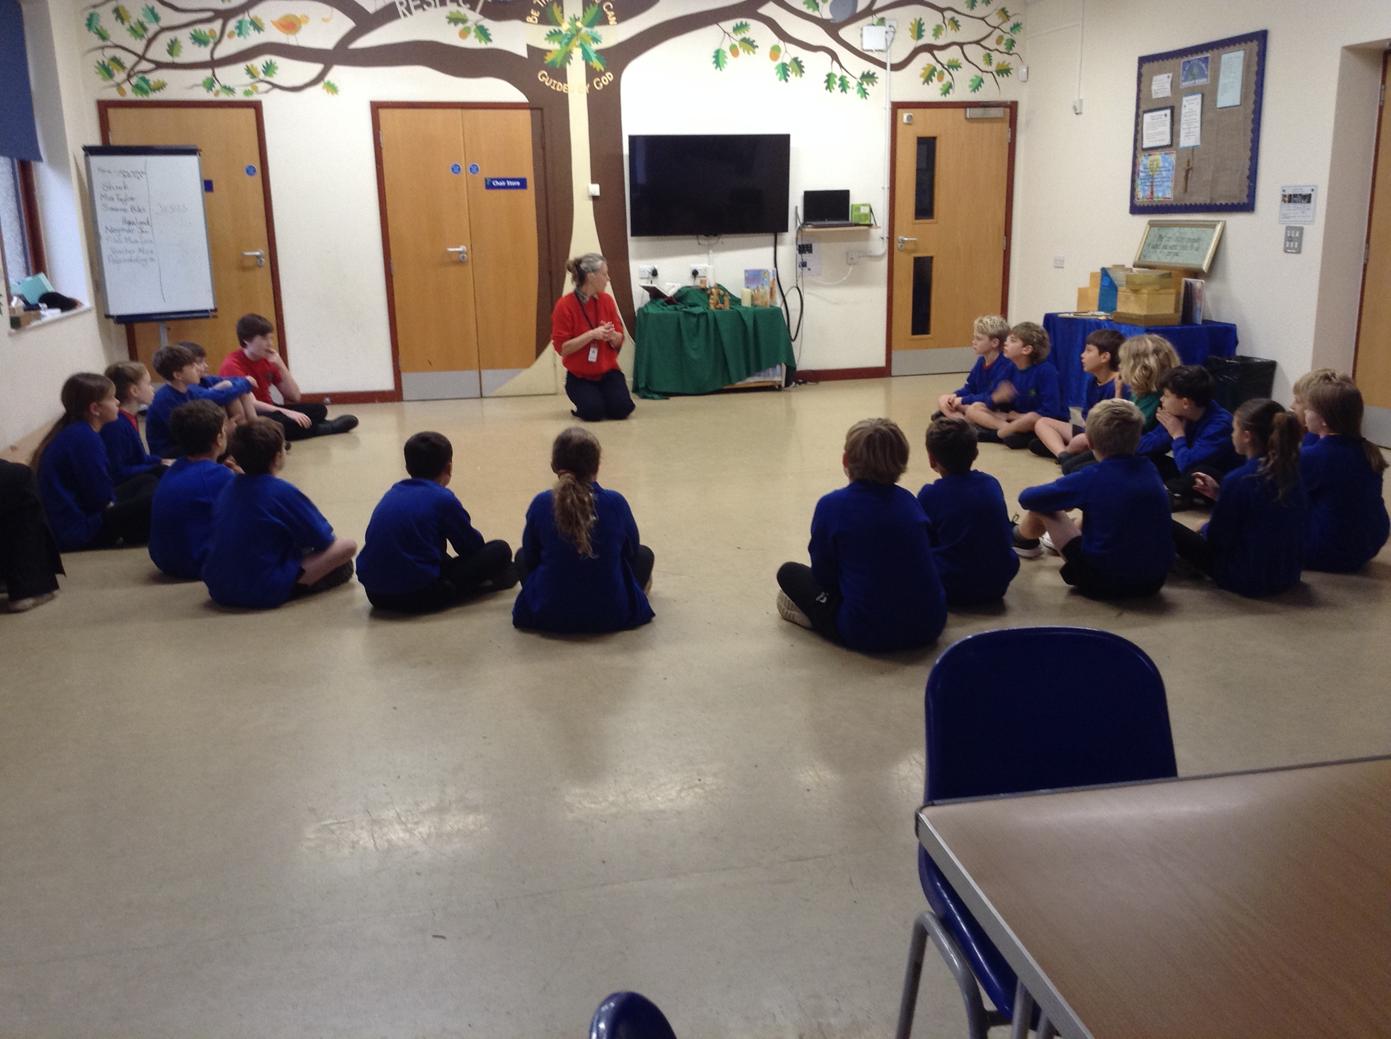
Godly Play- Lucy from the Wintershall Estate came to visit us to share bible stories and for us to engage in the making of a parable.

Slide 21
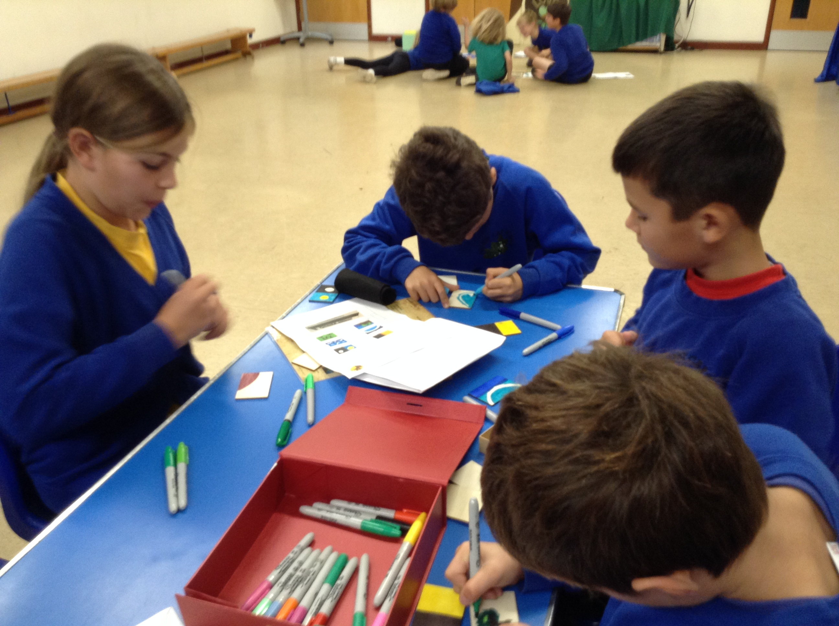
The children making the props for the Creation Story

Slide 22
RE- Visiting Haywards Heath Mosque

Slide 23
Computing- learning all about IP addresses and Data Packets
We learned about how data is transferred across the internet. We made our own data packets.

Slide 24
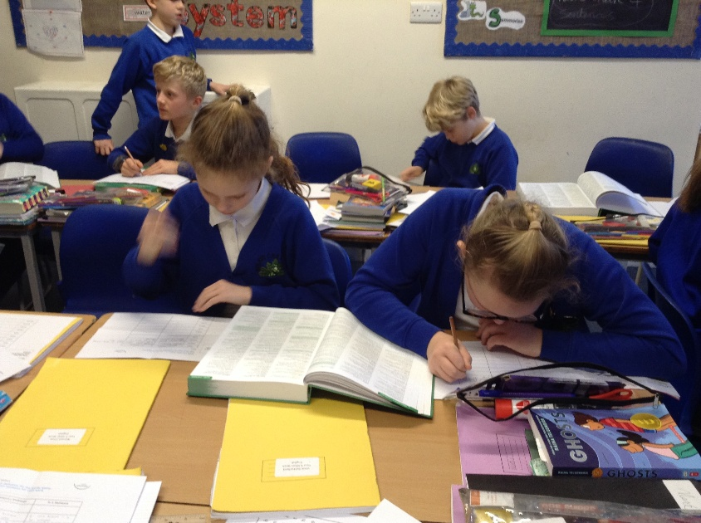
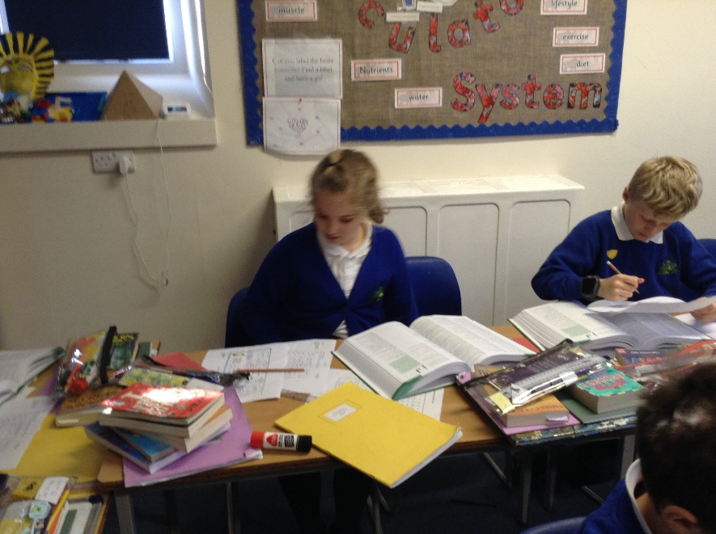
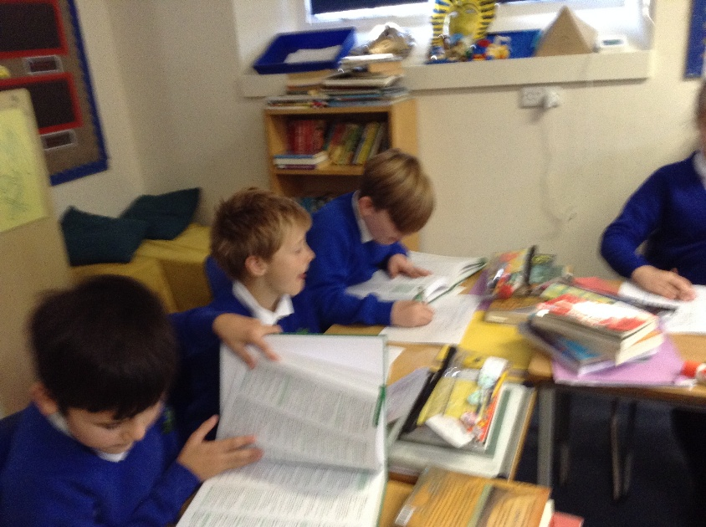
Using our new dictionaries
Gabe said ‘ I’d like one of this for home’.
We used these to look for definitions of our spelling words.

Slide 25
Haikus and Poppies
Children were asked to gather words for a poem about Remembrance Sunday. We decided we would write Haikus, 3 lined poems made up of 17 syllables; 5,7,5

