Slide 1
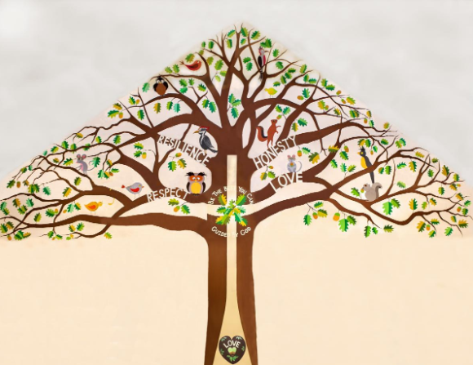
Welcome to Beech Class

Slide 2
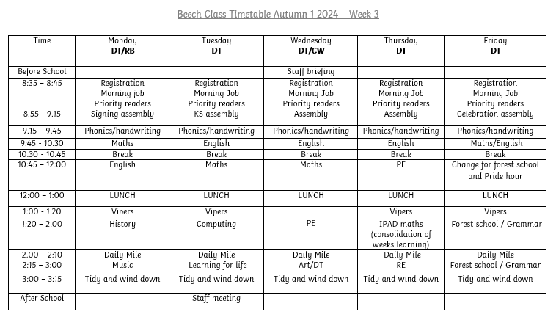
A Typical Week

Slide 3
Our Project Overview

Slide 4
Home Learning
Daily reading (and recording in Reading Diary) – We will provide your child with a phonics book from our scheme. However, if they are reading another book at home -fiction book, newspaper, magazine, non-fiction book, instructions, recipe, directions or any form of reading please add it in!
Times Table/maths Practice - You may use Numbots or TT rockstars. The log in is the same. Real life maths – shopping, baking, measuring and telling the time for example.
Homework Grid – This is on the website and has been emailed to you. It is full of a range of activities for you and your child to enjoy!
Spellings – These will be sent out on Friday via email and paper copy. I will be doing a spelling check on Thursday morning with the children. These spellings will inspired by the sounds we learn in the week and some common exception words (words where the usual spelling rule doesn't apply).

Slide 5
If you would like more home learning, let me know!

Slide 6
Our school website
https://www.bolneyschool.org.uk/web/

Slide 7
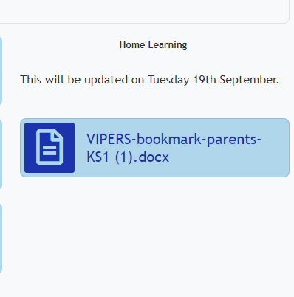
Home Learning (book changing)
Daily reading (and recording in Reading Diary) – Books will be changed on a Tuesday and a Friday. The children will be given a ‘reading level’ book and they can select a ‘choice book’ from the library or book corner. Please bring books back into school or we cannot change them. If you find that children are reading the book at speed after a few days, my advice would be to use the vipers suggestions on the website to support their comprehension further.
Your child will have the chance to read at school 1-1 with the TA during the week , this reading will be recorded in your child’s reading diary so please bring it everyday.

Slide 8
Quick Reminders
Bring a water bottle to school
Wear PE kits on PE days (Wednesday and Thursday)
Reading Records and reading books in book bags every day, especially book changing day
Make sure clothes and PE kit are clearly labelled with the correct name - especially second hand uniform
Check the uniform policy – ks1 shouldn't have backpacks

Slide 9
Useful Information
School Website: https://www.bolneyschool.org.uk/
School Phone Number: 01444 881352
Email Zoe in the office: office@bolneyprimary.school
Class Teacher email: dtaylor@bolneypriamry.school
I will respond to your email within 24 hours. I will respond between the hours of 8am and 6pm Monday-Friday. If your message is urgent, email the school office or call.

Slide 10
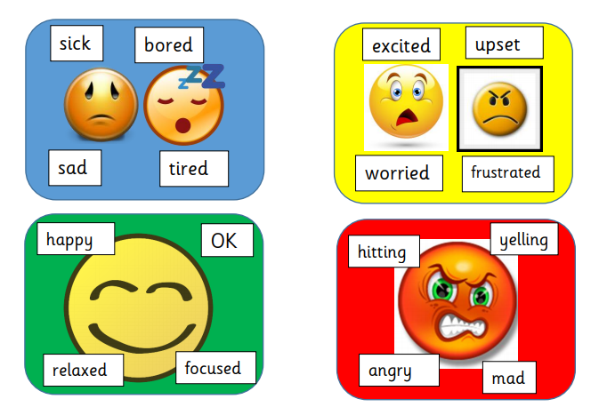
Well-being
Talk to your children and talk to us – we are here to listen and help.

