Slide 1

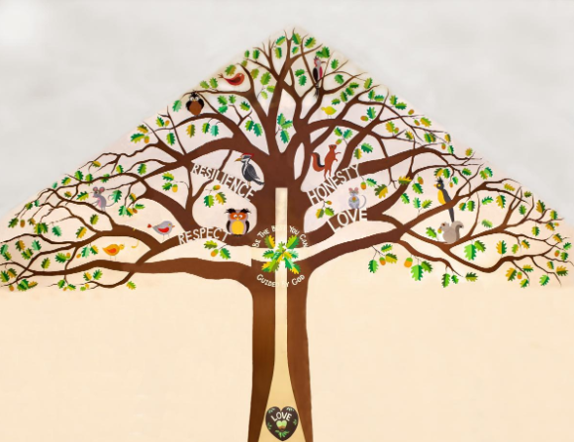
Welcome to Willow Class

Slide 2
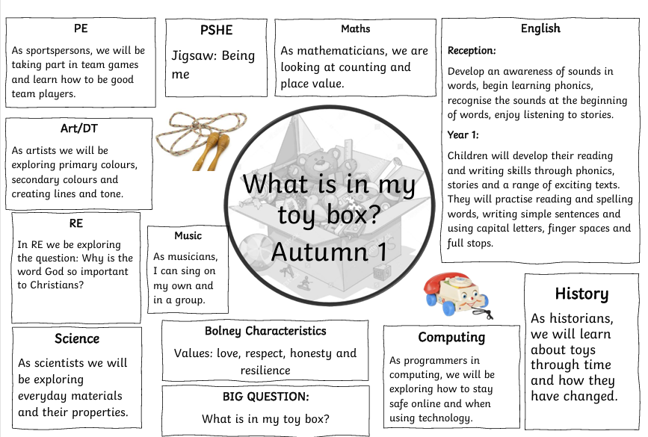
Our Project Overview

Slide 3

Home Learning
Daily reading (and recording in Reading Diary) – We will provide your child with a phonics book from our scheme. However, if they are reading another book at home -fiction book, newspaper, magazine, non-fiction book, instructions, recipe, directions or any form of reading please add it in!
Real life maths – shopping, baking, measuring and telling the time for example.
Homework Grid – This is on the website and has been emailed to you. It is full of a range of activities for you and your child to enjoy!

Slide 4
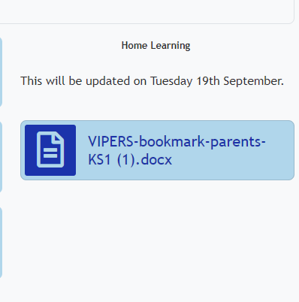
Home Learning (book changing)
Books will be changed on a Monday and a Thursday. The children will be given a ‘reading level’ book. Please bring books back into school or we cannot change them. If you find that children are reading the book at speed after a few days, our advice would be to ask questions about what you have read.
Your child will have the chance to read at school 1-1 with a TA or us during the week, this reading will be recorded in your child’s reading diary so please bring it everyday.

Slide 5
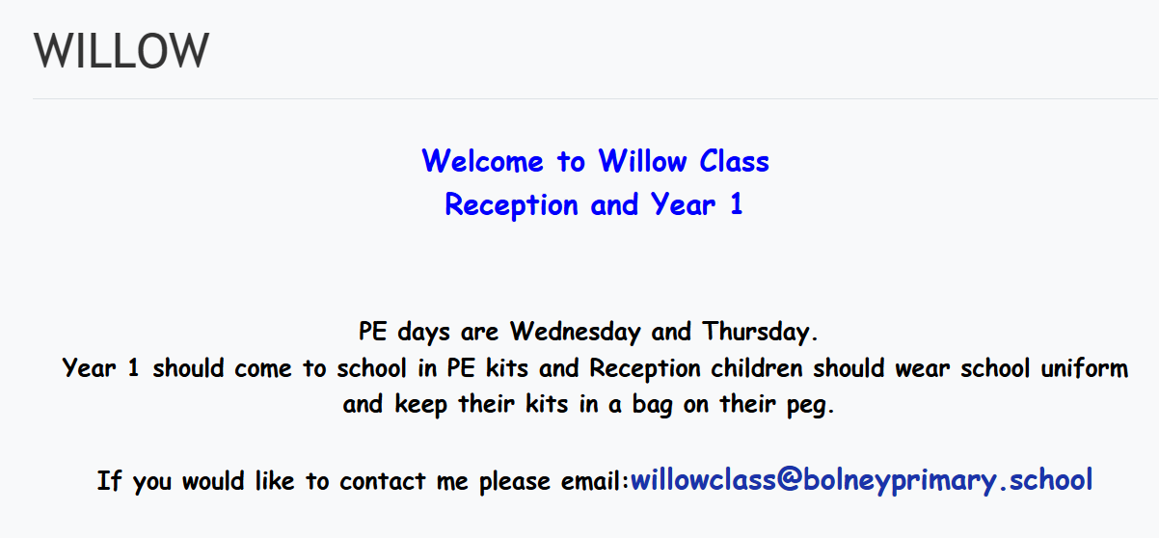
Our school website
https://www.bolneyschool.org.uk/web/

Slide 6
Quick Reminders
Bring a water bottle to school
Fruit or vegetable snack at break
Small toys – no thank you!
Year 1 wear PE kits on PE days (Wednesday and Thursday)
Reading Records and reading books in book bags every day, especially book changing day
Make sure clothes and PE kit are clearly labelled with the correct name - especially second hand uniform
Check the uniform policy – ks1 shouldn't have backpacks

Slide 7
Useful Information
School Website: https://www.bolneyschool.org.uk/
School Phone Number: 01444 881352
Email Zoe in the office: office@bolneyprimary.school
Class Teacher email: willowclass@bolneypriamry.school
We will respond to your email within 24 hours. We will respond between the hours of 8am and 6pm Monday-Friday. If your message is urgent, email the school office or call.

Slide 8
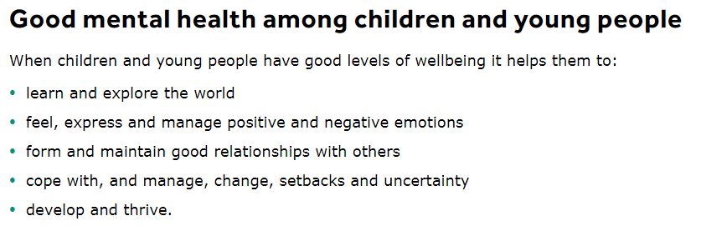
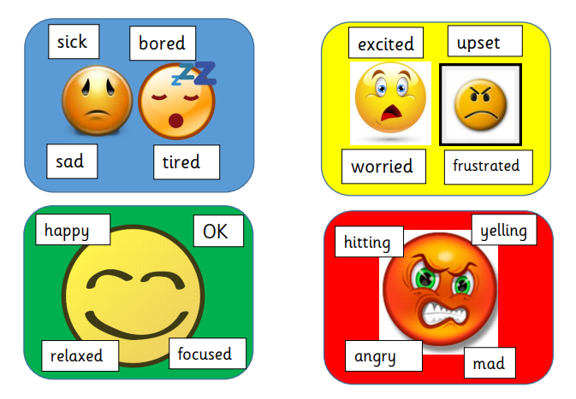

Well-being
Talk to your children and talk to us – we are here to listen and help.

