Slide 1

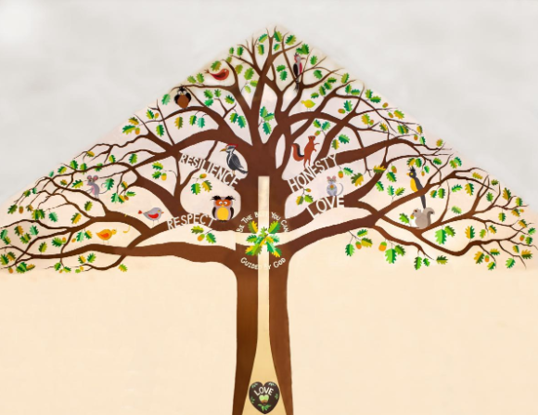
Welcome to Holly Class

Slide 2
A Typical Day
Early Morning Work – handwriting, spelling, times tables
Assembly
English
Break
Maths
Lunchtime
Art, Computing, History, Geography, Science, RE, RHE, Music

Slide 3
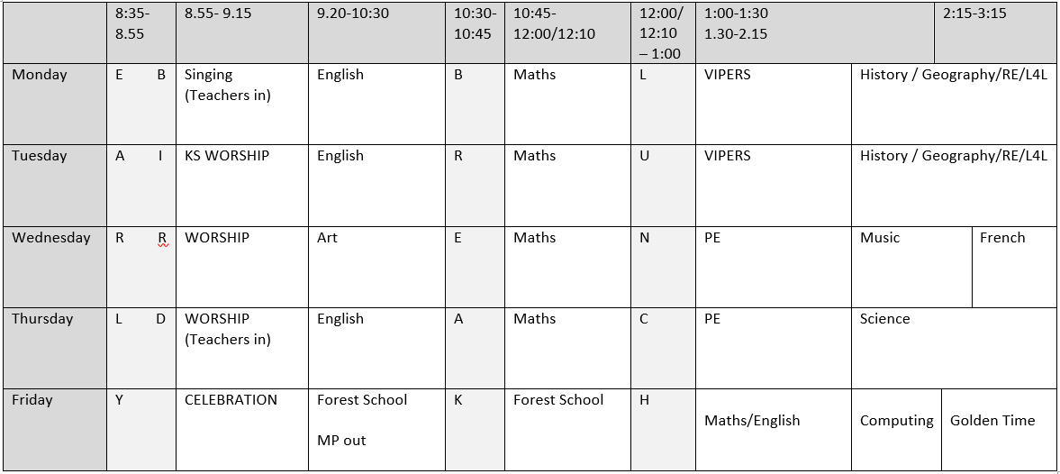
A Typical Week

Slide 4
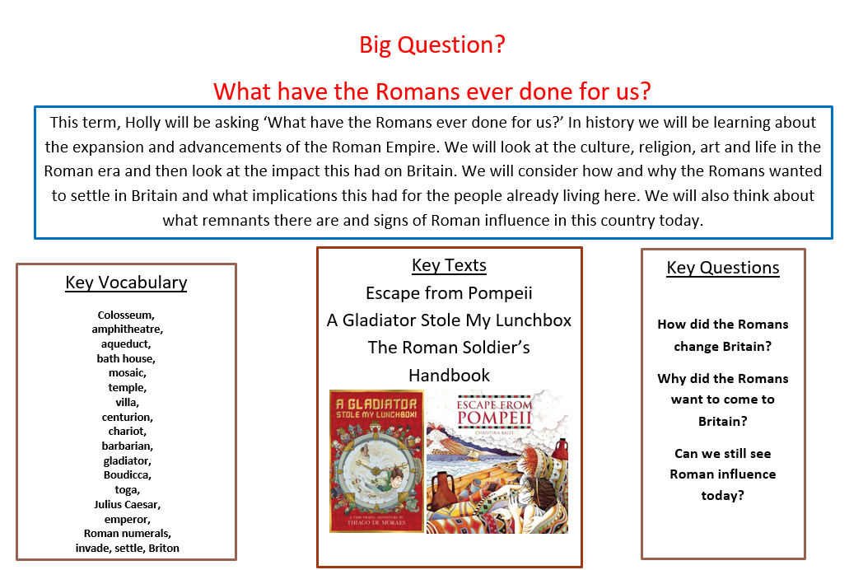
Our Project Overview

Slide 5
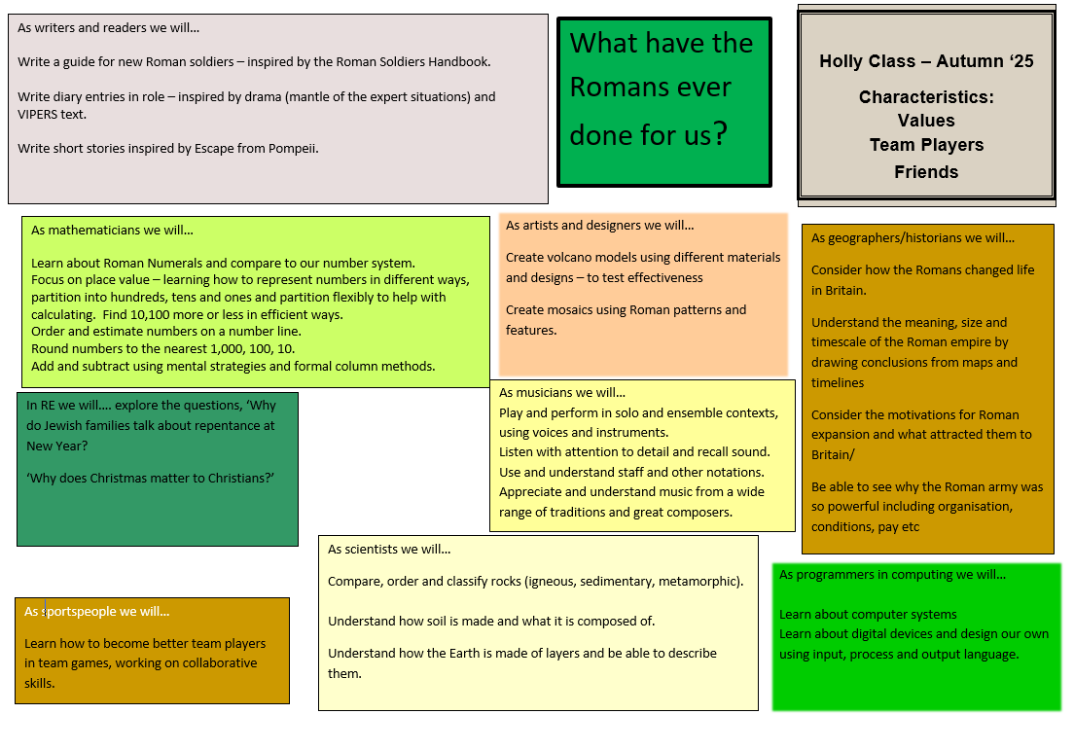

Slide 6


Our class book for this term
Not essential but own copies are really useful for engagement and following along in lessons.
Limited availability / expensive on amazon and waterstones.

Slide 7
Home Learning
This should include:
Daily reading
Times Table Practice – TTRockstars or Numbots
Using real life maths – shopping, baking, measuring and telling the time for example.
Spelling – a rule or list of words each week.
This will be put on the class page or sent home as a worksheet/activity.

Slide 8
Home Learning
Will be sent home on Friday
Expected back in and checked on Wednesday.

Slide 9
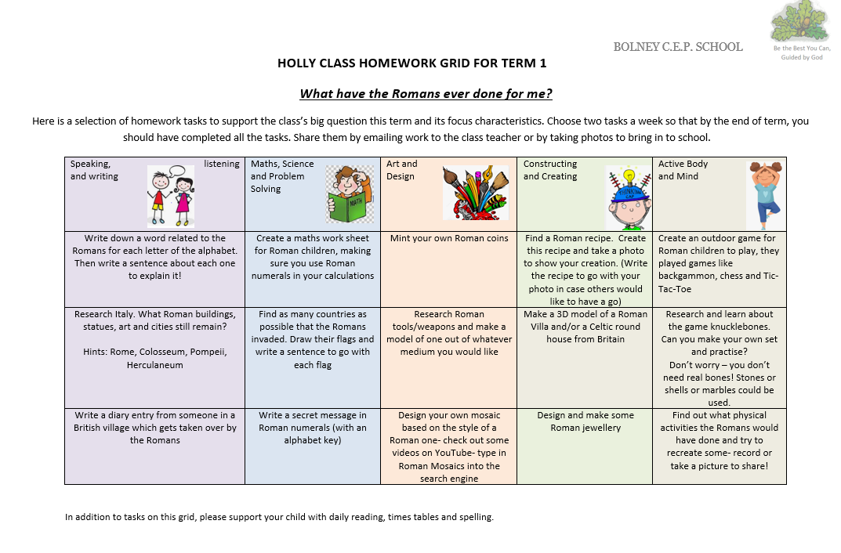
Home Learning grid

Slide 10
Quick Reminders
Bring a water bottle to school.
Wear PE kits on PE days – Wednesday/Thursday
Make sure clothes and PE kit are clearly labelled with the correct name - especially second hand uniform.
No pencil cases etc from home.
Check the uniform policy.

Slide 11
Useful Information
School Website: https://www.bolneyschool.org.uk/
School Phone Number: 01444 881352
Email Zoe in the office: office@bolneyprimary.school
Class Teacher email: mpitt@bolneyprimary.school
Please do not expect an immediate response. If you message is urgent, email the school office.

Slide 12
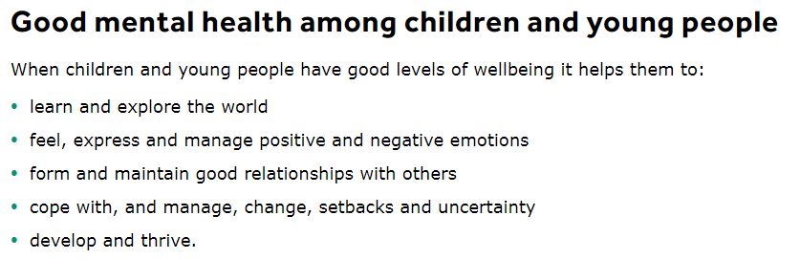
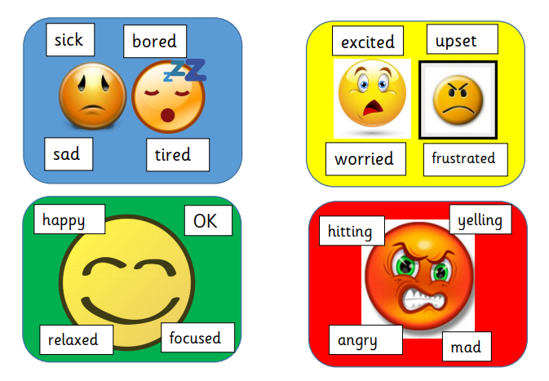

Well-being
Anna Freud Centre for Children and Families
Zones of Regulation – more information on the school website
Talk to your children and talk to us – we are here to listen and help.

