Slide 1
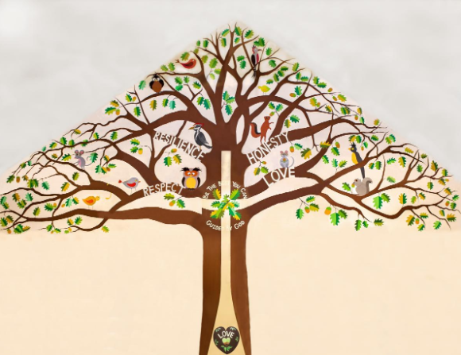
Welcome to Silver Birch Class

Slide 2
A Typical Day
Maths – sometimes split by year group, sometimes whole class
Assembly
English
Lunchtime
Art, Computing, History, Geography, Science, RE, RHE, Music

Slide 3
A Typical Week
 | 8:45-9:00 | 9:00-10:30 |  |  | 10:30-10:45 | 10:45-12:00/12:10 | 12:00/ 12:10-13:00 | 13:00-14:00 |  | 14:00-15:15
Monday | H A N D W R I T I N G / S P E L L I N G | Maths |  | Worship | B R E A K | English Guided Reading | L U N C H | Art |  | Computing
Tuesday |  | Maths |  | KS2 assembly |  | PE |  | RE |  | History
Wednesday |  | Maths |  | Singing assembly |  | English
 |  |  |  |  |  |  |  | Guided Reading | French | Drama
Thursday |  | Maths |  | Worship |  | English Guided Reading
 |  |  |  |  |  |  |  | History/ Geography |  | PE
Friday |  | Celebration Assembly | Maths |  |  | English |  | Science

Slide 4
Our Project Overview

Slide 5
Our class book for this term
Not essential but own copies are really useful for engagement and following along in lessons
Please discourage reading ahead – as children will not get chance to practise inference and predictive skills as much

Slide 6
Home Learning
This should include:
Daily reading This might be a fiction book, newspaper, magazine, non-fiction book, instructions, recipe, directions or any form of writing!
Times Table Practice - TTRockstars
Using real life maths – shopping, baking, measuring and telling the time for example.
Any additional home learning set by class teacher – for example the use of Spellingframe)

Slide 7
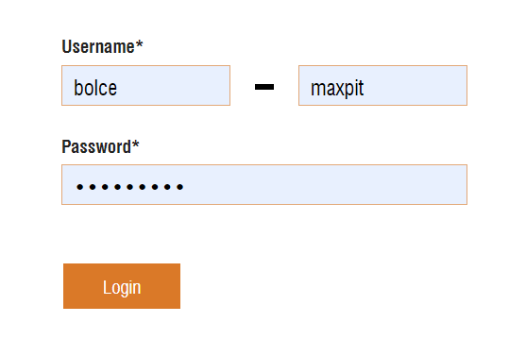
Home Learning
Spellingframe.co.uk
TTRockstars
We will send out log in information – any issues email me!

Slide 8
Quick Reminders
Bring a water bottle to school
Wear PE kits on PE days – Tuesday/Thursday
Make sure clothes and PE kit are clearly labelled with the correct name - especially second hand uniform
Check the uniform policy
Phones to be kept in office – handed to Zoe at start of the day

Slide 9
Useful Information
School Website: https://www.bolneyschool.org.uk/
School Phone Number: 01444 881352
Email Zoe in the office: office@bolneyprimary.school
Class Teacher email: mpitt@bolneyprimary.school
Please do not expect an immediate response. If you message is urgent, email the school office.

Slide 10
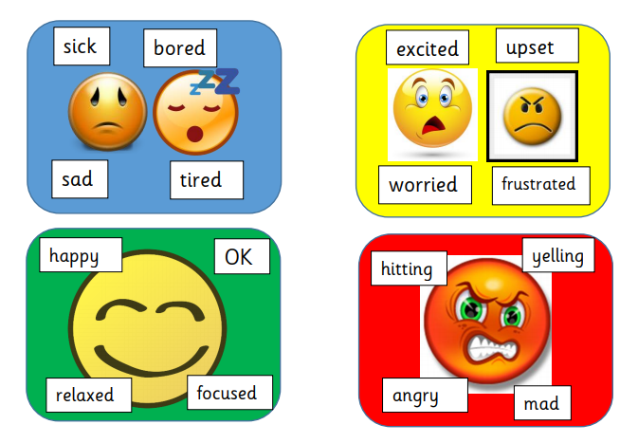
Well-being
Anna Freud Centre for Children and Families
Zones of Regulation – more information on the school website
Talk to your children and talk to us – we are here to listen and help.

