Slide 1
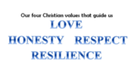
Monday 24th April 2023
Big Questions
King’s Coronation
Spirituality

Slide 2
Monday 24th April 2023
Big Questions

Slide 4
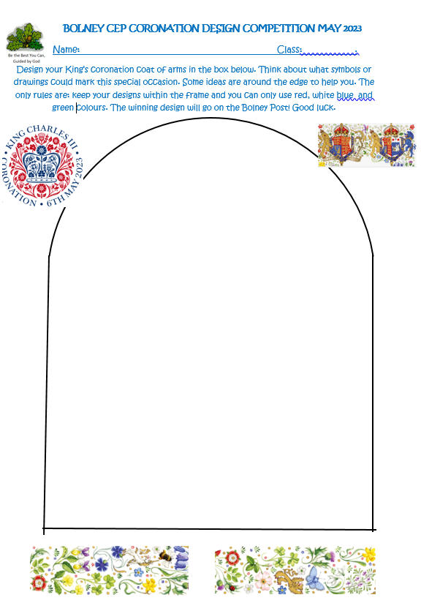

Slide 5
What does spirituality mean to you?

Slide 6
Spirituality is not something we can see; it is something we feel inside ourselves. It is about:
awe and wonder,
asking questions,
caring for nature and living things
wanting to love and to be loved by people

Slide 7
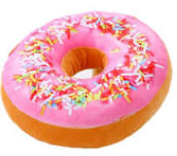

Slide 8
The hole is like the spirit: you can’t see it but it is there.
The ring donut represents the whole person.
If there were no hole, it wouldn’t be a ring donut. If we didn’t have spirituality, we wouldn’t be whole.

Slide 9
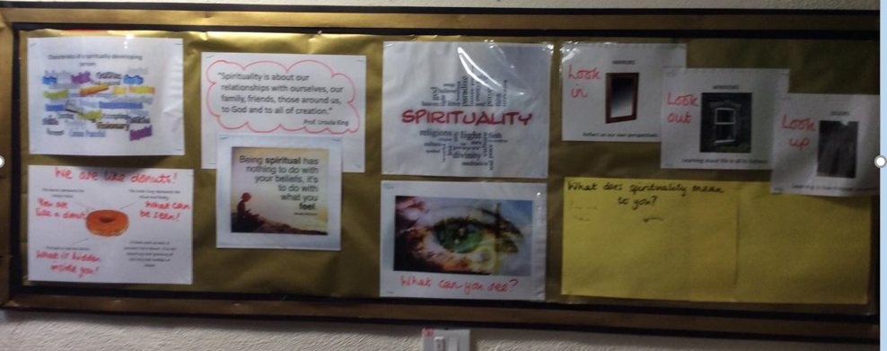

Slide 10
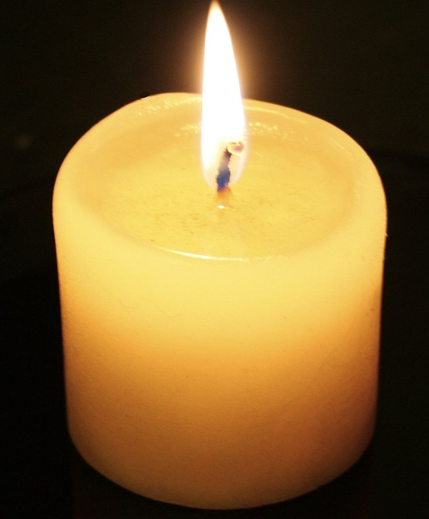
Reflection Time

Slide 11
Dear Lord,
Thank-you for this lovely school.
Guide us to make the right choices
and
Help us to remember our values.
You hold the hands of everyone and lift the hearts of us all.
Watch down on us when we try our best
and
Help us to work together.
We will trust in you forever.
Amen

