Slide 1
SEND Provision at Bolney CEP School

Slide 2
The Role of a SENDCO in schools
Oversee the strategic development of SEN policy and provision
Ensure the implementation of the SEN policy on a day-to-day basis
A key point of contact for colleagues and can offer support and advice for the identification of needs and suitable provision to meet those needs
Through provision management, they will maintain an overview of the progress of pupils with SEND
Seeks to develop practice to ensure the effectiveness of interventions and support
(NASEN – National Association for Special Education Needs)

Slide 3
Current Interventions
Handwriting
Narrative Therapy
Lego Therapy
Phonics
Sensory Circuits
Nessy
Numbots
Class Priority readers
SATs Breakfast Club
Use of Clicker 8
Learning Mentor
These interventions run in addition to the targeted TA/Teacher support that is
highlighted on teachers plans.

Slide 4
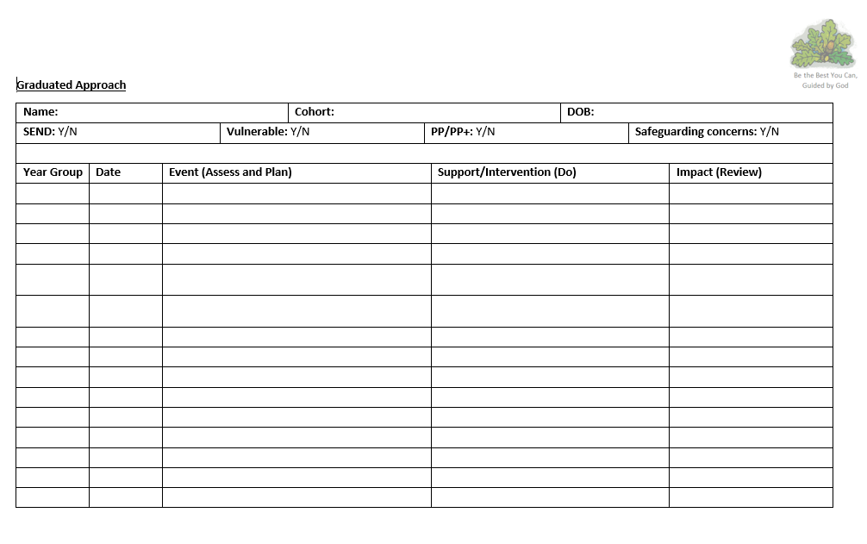
How support is monitored for children with SEND need
Graduated Approach Forms
Children with SEND need
SENDCO writes up provision during pupil progress meeting (x3 yearly)
Teachers review the impact as part of data collection (3x yearly)

Slide 5
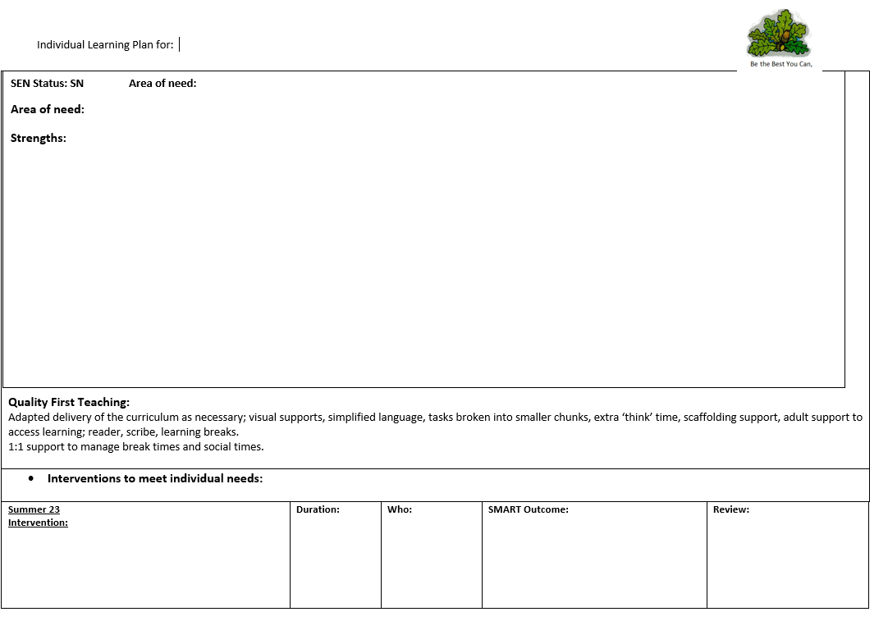
How support is monitored for children on the SEND register
Individual Learning Plans (ILPs)
Children on the SEND register.
SMART targets to work towards larger targets
Teacher create and review these 3x yearly
To be shared with parents.

Slide 6
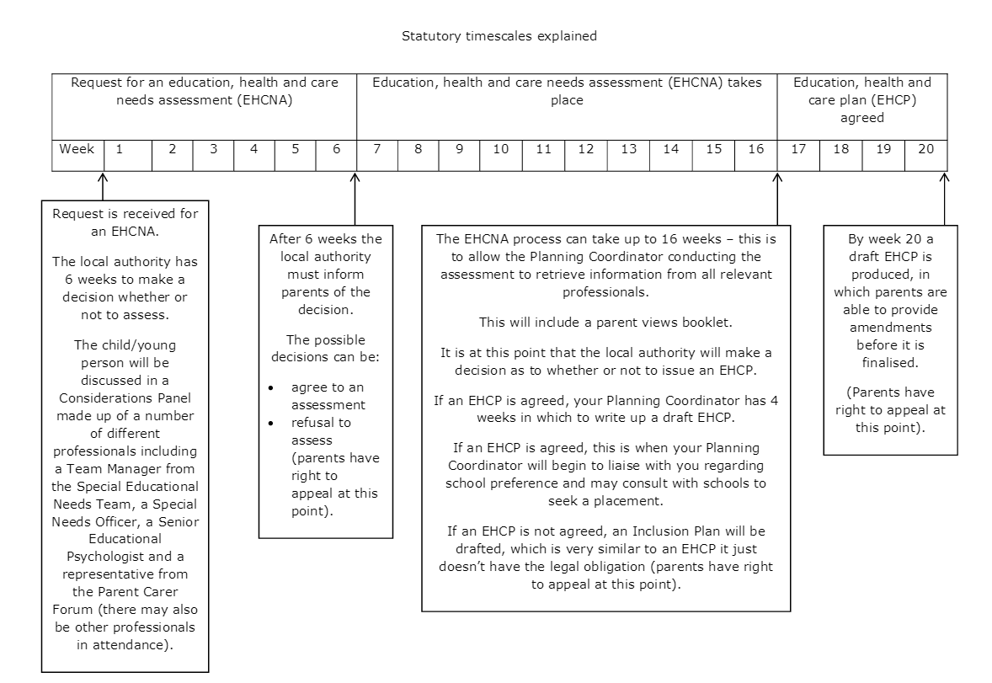
If further support is needed
Education, Health and Care Plan (EHCP)
If children still are not making adequate progress, and the school deem it necessary, an application for an EHCP will be made to the local authority.
This will bring additional funding to the school for that child.
Time scales are lengthy and often delayed due to lack of specialist staff such as Educational Psychologists.
The current climate is the LA are rejecting quite a few applications.

