Slide 1

Inclusion at Bolney CEP School

Slide 2


Slide 3
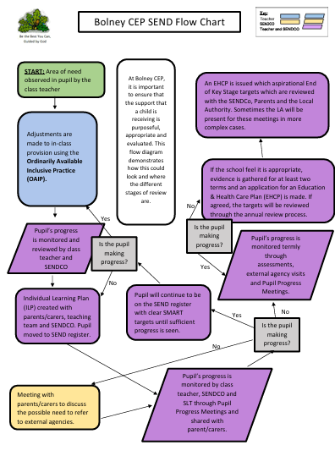
At Bolney CEP, it is important to ensure that the support that a child is receiving is purposeful, appropriate and evaluated. This flow diagram demonstrates how this could look and where the different stages of review are.
This document can be viewed in full below.

Slide 4
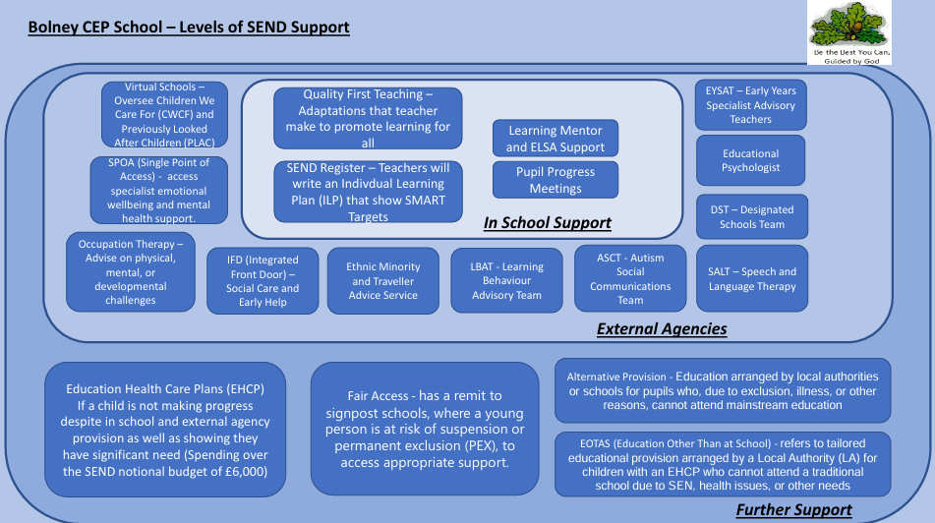

Slide 5





Current Interventions
Handwriting
Narrative Therapy
Precision Teaching
Lego Therapy
Phonics
Sensory Circuits
Numbots
Class Priority readers
SATs Breakfast Club
Use of Clicker 8
Learning Mentor/ELSA
These interventions run in addition to the targeted TA/Teacher support that is
highlighted on teachers plans.

Slide 6
How support is monitored for children on the SEND register
Targeted Support To include: a specific target based on the child’s assessment grids, a measurable outcome and a next step when considering the impact
SMART Target | Intervention | Duration | Delivered by | Impact
By February half term, XXXX will be able to partition 2-digit numbers using diennes blocks | 1:2 Support in Maths | 5x weekly | AB, CD | XXXXX is able to do this with equipment. Next step – 3-digit numbers
By February half term, XXXX verbally say a sentence aloud before writing it. | 1:2 Support in Writing | 5x weekly | AB, CD | XXXXX is able to do this. Next steps – To punctuate sentences using actions when sounding out sentences.
By Easter, be re-enter the classroom ready to learn. | Sensory Circuits | 3x weekly | EF | Much more focus. Next Steps - to continue.
By Easter, consolidate learning of split digraphs to create long vowel sounds. | Phonics Intervention | 2x weekly | CD | Assessment showed progress. Still some gaps. Next Steps – u_e and i_e
By Easter, XXXX will be able to read 60 words a minute | Precision Monitoring | 5x weekly | CD | Last assessment 65 words a minute. Next steps – 75 words
By Easter, XXXX will be able to spell 10 Year 1 words correctly. | Multi-Sensory Reading Intervention (Toe to Toe) | Daily | CD | Met Next steps – To spell all Year 1 words correctly
Individual Learning Plans (ILPs)
Children on the SEND register.
SMART targets to work towards larger targets
Teacher create and review these 3x yearly
To be shared with parents.

Slide 7
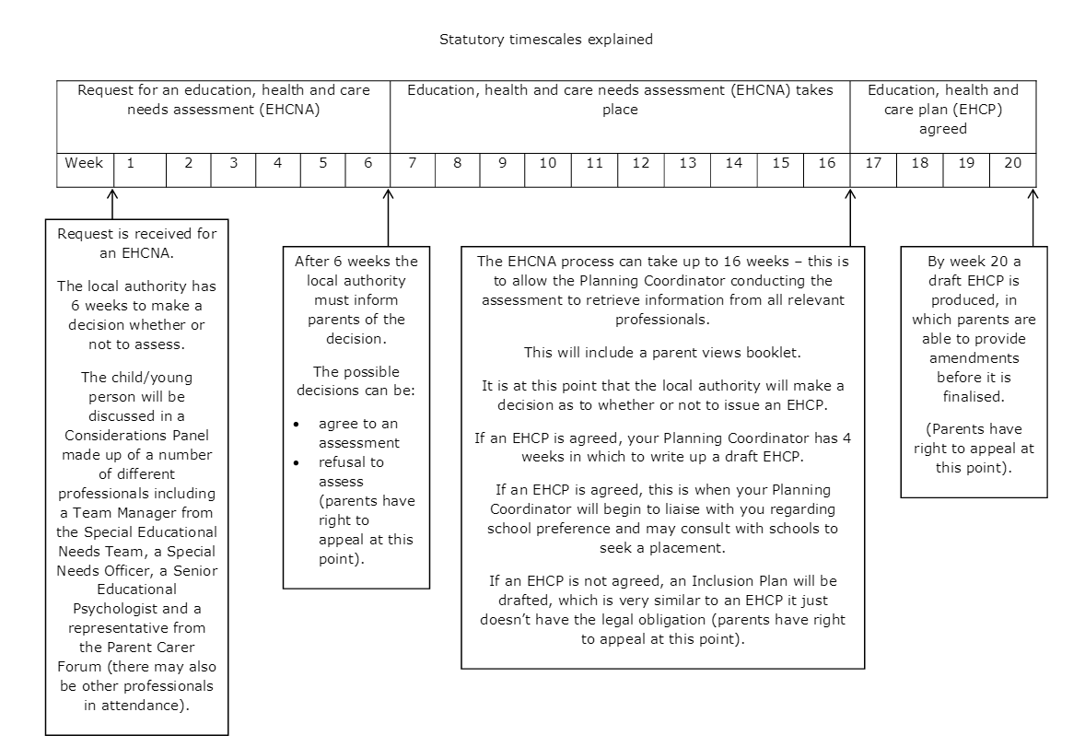
If further support is needed
Education, Health and Care Plan (EHCP)
If children still are not making adequate progress, and the school deem it necessary, an application for an EHCP will be made to the local authority.
This will bring additional funding to the school for that child.
Time scales are lengthy and often delayed due to lack of specialist staff such as Educational Psychologists.
The current climate is the LA are rejecting quite a few applications.

Slide 8

The Role of a SENDCO in schools
Oversee the strategic development of SEN policy and provision
Ensure the implementation of the SEN policy on a day-to-day basis
A key point of contact for colleagues and can offer support and advice for the identification of needs and suitable provision to meet those needs
Through provision management, they will maintain an overview of the progress of pupils with SEND
Seeks to develop practice to ensure the effectiveness of interventions and support
(NASEN – National Association for Special Education Needs)

Slide 9
For anymore additional information, please do look at the links and documents at the bottom of the page.

