Slide 1

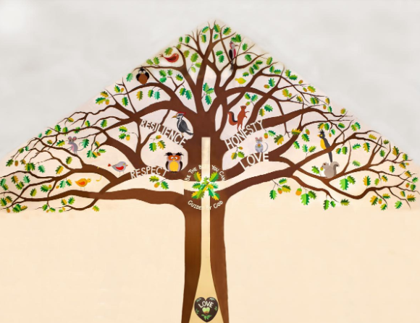
Welcome to Silver Birch Class

Slide 2
A Typical Day
Early Morning Work- 8.35 to 8.55
Assembly
Maths
Playtime
Spelling/Handwriting
English
Lunchtime
VIPERS/Independent reading/SATs papers
Project Work (Art, Computing, History, Geography, Science, Learning For Life, R.E)
Other areas of the curriculum- Languages, Music, P.E

Slide 3
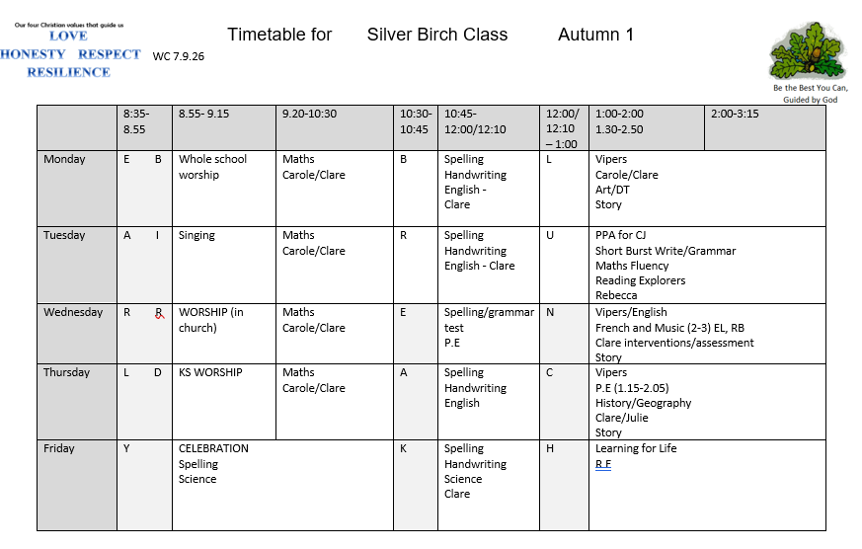
A Typical Week

Slide 4
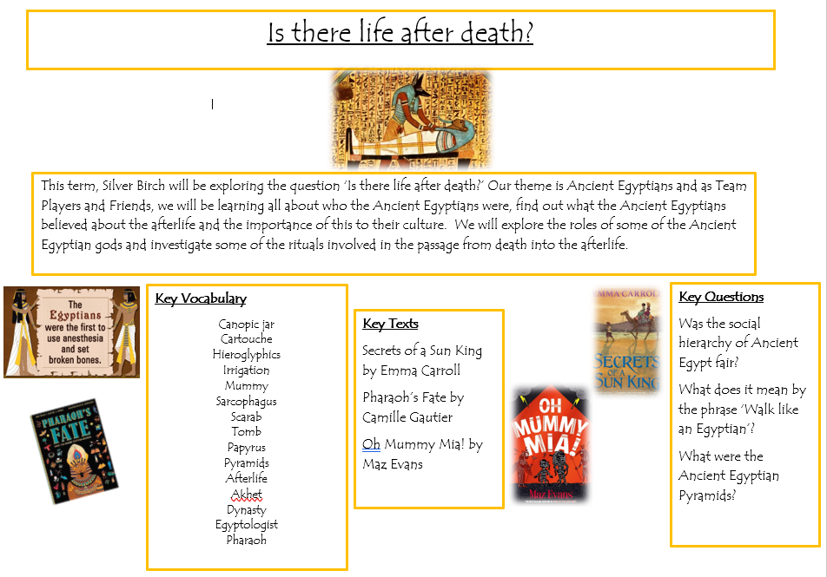
Our Autumn term learning journey, please see copies on tables and please take one home, they are also on the class page on the school website.

Slide 5
Home Learning
This should include:
Daily reading -This might be a fiction book, newspaper, magazine, non-fiction book, instructions, recipes, directions or any form of text!
Times Table Practice using the website ‘timestables.co.uk’ and TT Rockstars
Using real life maths – shopping, baking, measuring and telling the time for example

Slide 6
Spellings- common exception words and spelling patterns taught in school using Spelling Frame/Spelling Shed and completing a paper copy, given out on Fridays. I collect this in on Wednesdays.
All children need to complete the home learning set- your child may be working on Year 2/3/4 words but you can still use Spelling Frame and Spelling Shed for these words. Please find copies of the CEW on tables and please take one.
A Topic grid every term linked to the big question.
In UKS2, if home learning isn’t handed in, children miss one of their break times in order to complete it, however, we will be starting to run a Homework club on a Monday lunchtime where children can complete their home learning instead of at home, go on TTRS/Spelling Shed or if they have not handed in their home learning, they will need to join in with the club.

Slide 7
Our Autumn term home learning grid, on tables and also on the class page of the school website.

Slide 8
More about reading…
We read daily and I always read to the children. We have independent reading time where the children are able to read in the book corner and we have whole class reading time where we all read together, myself and the children and we read the same text.
VIPERS is an acronym to aid the recall of the 6 reading domains as part of the UK’s reading curriculum. Reading Vipers
Vipers is a range of reading prompts based on the 2016 reading content domains found in the National Curriculum Test Framework documents.
To be able to fully embrace Vipers, we need to purchase enough books for every child. I will give you notice about the book I would like us to use at the end of each term for the start of the next term. Thank you for your ongoing support with this- it has been really helpful.
SATS- we practise regularly using reading booklets to ensure the children have no surprises when faced with a SATS paper. I will contact Year 6 parents nearer the time regarding any extra support/home support you may need.

Slide 9

If you would like to take a recommended book list for Years 5 and 6, please help yourself!

Slide 10
Quick Reminders
Bring a named water bottle to school
Wear P.E kits on P.E days (Wednesday and Thursday)
Make sure clothes are clearly labelled with the correct name - especially second-hand uniform
Change of clothes for Forest School (We will send out reminders when we are doing this- after half term so November)
Check the uniform policy- black and white socks only please!
All documents- home learning, letters, spellings etc are all on our class page on the website.
Parents Consultation Evenings: 20th and 21st October 2026

Slide 11
Useful Information
School Website: https://www.bolneyschool.org.uk/
School Phone Number: 01444 881352
Email Zoe in the office: office@bolneyprimary.school
Class Teacher email: cjames@bolneyprimary.school
Please do not expect an immediate response. If your message is urgent, email the school office. I do use Brom Com for most emails and correspondence, please let me know if this is a problem.

Slide 12
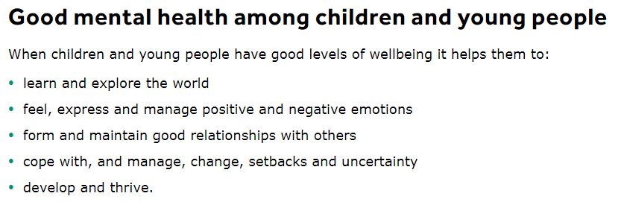
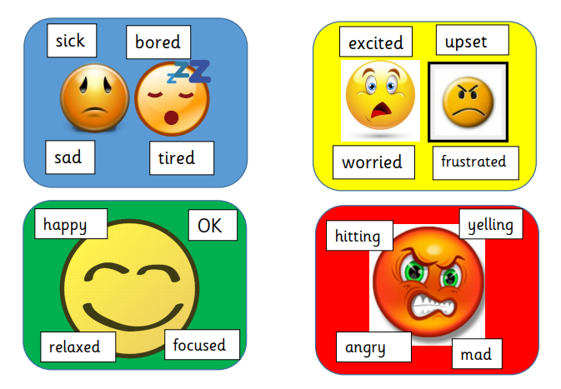
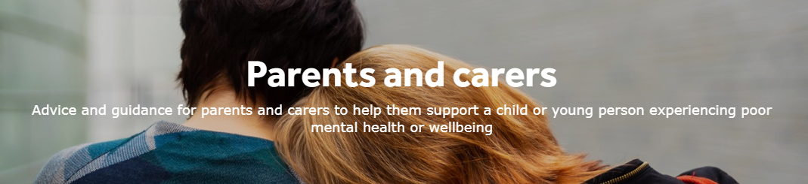
Well-being
Anna Freud Centre for Children and Families
Zones of Regulation – more information on the school website
Talk to your children and talk to us – we are here to listen and help

Slide 13
PGL Windmill Hill, our residential 22nd- 26th September 2025
We arrive at Windmill Hill for 12pm, we will be met by our group leader. They will show us our rooms and we will have a tour of the grounds.
We start the activities at 14.00pm on the Monday, Micro Scooters, Canoeing, Abseiling and Orienteering.
Reminders:
Please remember that your child will have to have eaten before arriving at the centre.
Remember to bring bedding (sleeping bag and pillow).
It is a good idea to provide a black plastic sack within their luggage for dirty/wet clothing.
No aerosols please and definitely no tech please!
We are extremely close to the amenities such as the sports hall, dinner hall and shop.
We will be split into 3 groups for the daytime activity programme. Each group will have an adult as well as a group leader from PGL.
Each activity runs for 90 minutes. There are 6 activities in the morning and 6 in the afternoon.
We are altogether for the evening and mealtimes. There is time to visit the shop after the evening entertainment or when we have free time.
We do not have our times for meals yet, we will receive this on arrival. The first activity starts at 9am, the last activity ends at 5.10pm. Lunch takes place between 12.10 and 2.00pm. Dinner takes place between 5.10pm and 7.00pm.
Evening entertainment is from 7.30pm to 8.30pm and then bedtime!!

